Slide 1
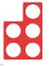
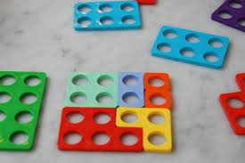

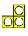

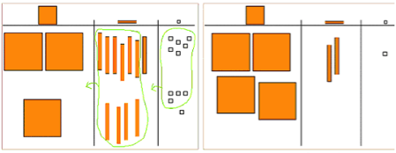
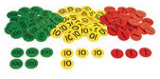
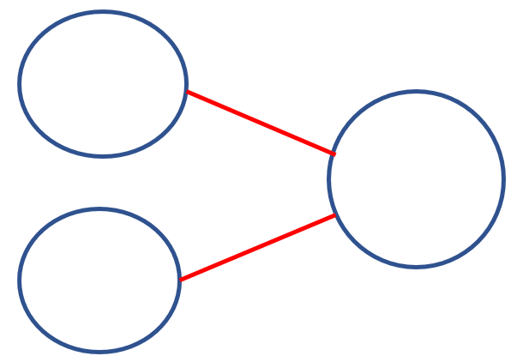
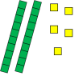

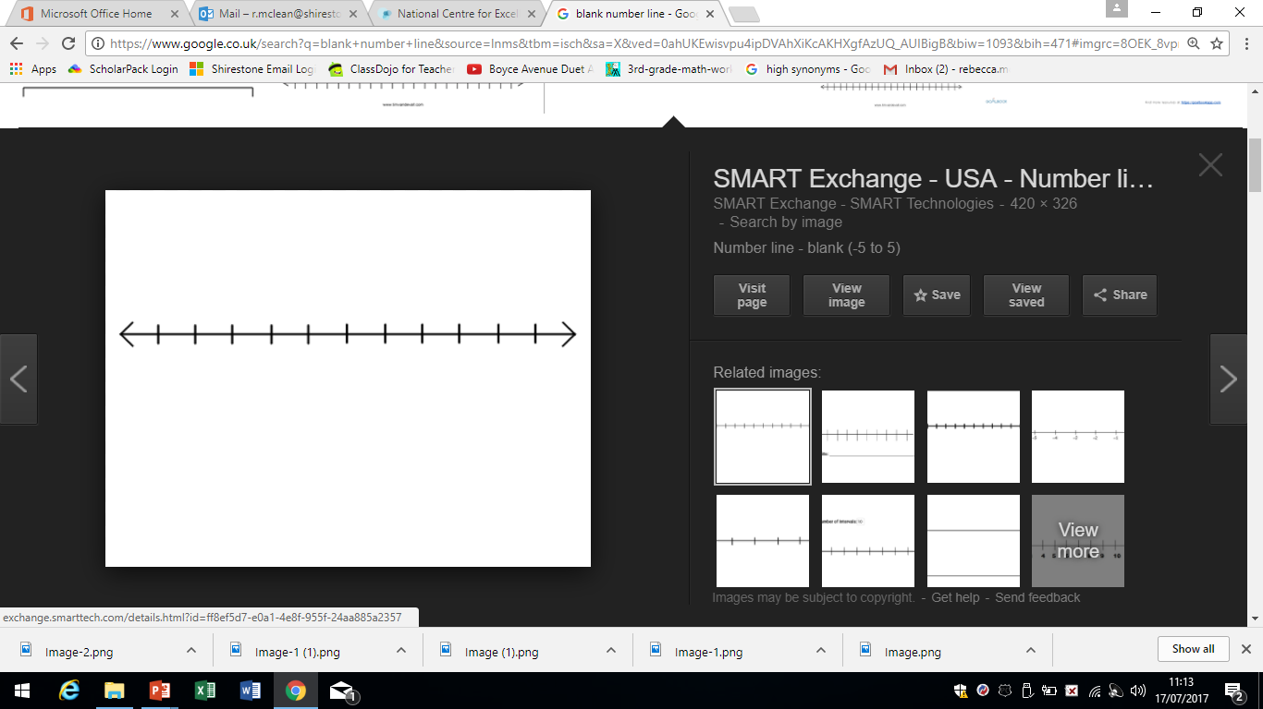
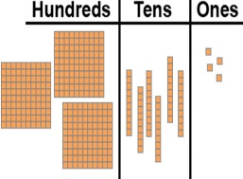
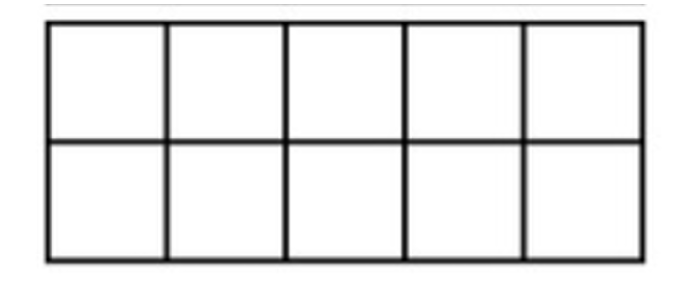
Progression in addition
Add one more to numbers up to 20 practically. Develop understanding of addition up to 20. (Concrete using objects) (Pictoral) (Abstract) 5 + 3 | Use the language of put together, add, altogether, double (repeated addition) and total. Read, write and interpret + and = 5 + 3 = 8 Know number bonds to 20 in several forms e.g. 9 + 11 = 20, 9 + 7 = 16 Solve simple 1 step addition problems using concrete and pictoral representations. | Extend language to include the same (linking to commutative law). Recall and use + facts to 20 fluently. Derive and use + facts to 100. 3 + 7 = 10 so… + 70 = 100 Add using concrete objects and pictoral representations and mental calculations (TO+O, TO+T, TO+TO, O+O+O) 25 + 47 = 72 | Add mentally (HTO+O, HTO+T, HTO+O) Add numbers with up to 3 digits efficiently. 6 tens 12 units (1 ten and 2 units) | Continue to add mentally using larger numbers. Continue to reinforce efficient written methods to add up to 4 digits including decimals. Move to more abstract representation of place value counters. | Continue to add mentally using larger numbers with increased fluency. Continue to reinforce efficient written methods to add more than 4 digits including decimals. | Continue to add mentally using larger numbers with increased fluency. Continue to reinforce efficient written methods to add more than 4 digits including decimals., moving away from using concrete objects when fully fluent and secure conceptually. Explore addition using brackets.
Throughout, use cuisenaire to reinforce the related subtraction facts and that addition of 2 numbers can be done in any order (commutative law).
 | 2 | 5
+ | 4 | 7
 | 7 1 | 2
 | 2 | 7 | 6 | 3 | 8
+ |  | 4 | 5 | 0 | 6
 | 2 1 | 2 1 | 1 | 4 1 | 4
 | 2 | 7 | 6
+ | 1 | 4 | 5
 | 4 1 | 2 1 | 1
e.g. 4 + 8 = 12, 8 + 4 = 12, 12 – 4 = 8 etc
e.g. 3.9 + 4.8 = 8.7, 4.8 + 3.9 = 8.7 etc

