Slide 1

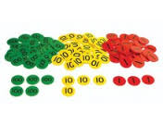
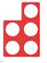
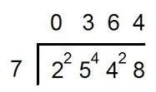
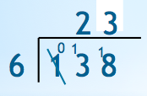
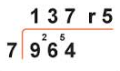
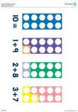
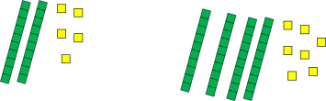
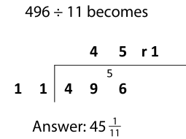
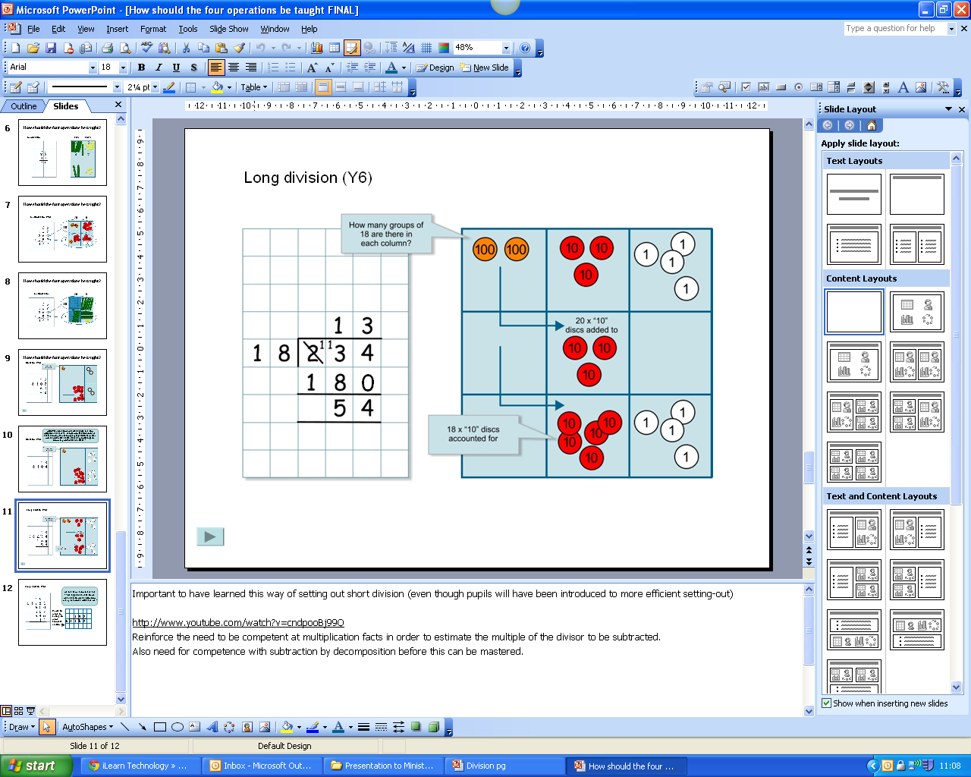
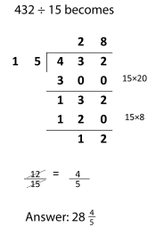
Progression in division
Practical activities sharing objects. Practical activities grouping objects. 3 groups of 2. | Solve simple 1 step ÷ problems using concrete objects, pictoral representations and arrays with teacher support. Understand grouping and sharing of small quantities. Find ½ and ¼ of small numbers, objects and quantities. | Recall and use ÷ facts for 2, 5 and 10x tables and write statements using the symbols. 15 ÷ 3 = 5 Develop understanding of grouping and sharing. 36 ÷ 3 = 12 Demonstrate that ÷ of 2 numbers cannot be done in any order. ÷ mentally by 10 and 100. 20 ÷ 10 = 2 | Recall and use ÷ facts for 3, 4 and 8x tables. Write mathematical ÷ statements for known x tables including TO÷O. Develop written methods for TO÷O. 86 ÷ 4 = 21 r 2 Develop mental ÷ strategies, including ÷ by 10, 100 and 1000. | Recall ÷ tables facts up to 12x12. Know the effect of ÷ by 0 and 1. Use place value, known and derived facts to ÷. Work towards HTO÷O using short division. Develop mental strategies including ÷ whole numbers and 1dp mentally by 10, 100 and 1000. | ThHTOxO using short division. Interpret remainders in context. Develop mental strategies including ÷ whole numbers and decimals mentally by 10, 100 and 1000. Scale down by simple fractions. | Explore ÷ using brackets (BODMAS). ThHTO÷TO (whole numbers) using short multiplication. Express remainders as fractions, decimals or rounding by context e.g. Develop an awareness of long division.
Recognise and use the inverse relationship between x and ÷ using scaling up and scaling down image.
23
6
138
2 times
as tall
e.g. 8 x 2 = 16, 16 ÷ 2 = 8

