Slide 1
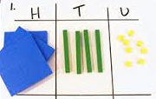
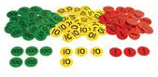

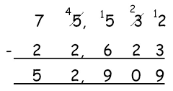
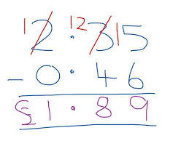
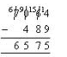
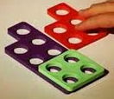
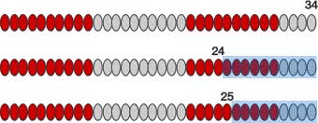
Progression in subtraction
General | Finding one less than numbers up to 20 practically. Counting back using practical equipment and a number track. | Represent and use related subtraction facts of number bonds to 20. Know number bonds to 20 in several forms e.g. 16 – 7 = 9, 7 = 16 – 9 Read, write and interpret - and = Solve simple 1 step subtraction problems using concrete and pictoral representations. | Recall and use - facts to 20 fluently. Derive and use - facts to 100. 10 – 7 = 3 so… 100 – 70 = 30 Add using concrete objects and pictoral representations and mental calculations (TO-O, TO-T, TO-TO, O-O-O) | Subtract mentally (HTO-H, HTO-T, HTO-0) Subtract numbers with up to 3 digits efficiently. | Continue to subtract mentally using larger numbers. Continue to reinforce efficient written methods to subtract up to 4 digits including decimals. | Continue to subtract mentally using larger numbers with increased fluency. Continue to reinforce efficient written methods to subtract more than 4 digits including decimals. | Continue to subtract mentally using larger numbers with increased fluency. Continue to reinforce efficient written methods to subtract more than 4 digits including decimals., moving away from using concrete objects when fully fluent and secure conceptually. Explore using brackets.
Taking away | Practical demonstrations of ‘taking away’. | Use the language of take away. 17 – 12 = 5 | 72 – 47 7 2 |  | Move to more abstract representation of place value counters.
Finding the difference | Comparing numbers up to 20. | Use the language of less than and more than. 9 – 4 = 5 9 is 5 more than 4 4 is 5 less than 9 | Extend language to include the difference. 72 - 25 | Increase efficiency of jumps. | Develop use of jottings to become more efficient: e.g. 7064 – 489 + 511 (1000), +6064 (7064) = 6575 e.g. £2.35 = £0.46 + 54p (£1), + £1.35 (£2.35) = £1.89
 | Throughout, use cuisenaire to reinforce the related addition facts and that subtraction of 2 numbers cannot be done in any order.
3
1
 | 3 | 4 | 8
- |  | 6 | 9
 | 2 | 7 | 9
6
1
25
69
7064
72
348
489
+5 +40 +2
+31 +200 +48
25 30 70 72
69 100 300 348
e.g. 12 – 4 = 8, 8 + 4 = 12 etc
e.g. 8.7 - 3.9 = 4.8, 4.8 + 3.9 = 8.7 etc

