Slide 1
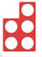
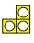
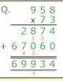
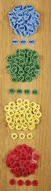
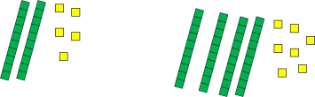
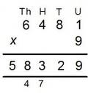
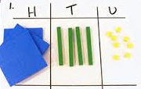
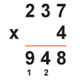
Progression in multiplication
Counting in steps of 2 using objects and number tracks. Grouping objects (repeated addition). 2 + 2 + 2 2, 4, 6 | Solve simple 1 step x problems using concrete objects, pictoral representations and arrays with teacher support. Record as repeated addition and link to x using the language of lots of, groups of. 3 + 3 + 3=9 3 x 3 = 9 Double small numbers and quantities. 5 + 5 = 10 5 x 2 = 10 | Recall and use x facts for 2, 5 and 10x tables and write statements using the symbols. 5 x 3 = 15 Demonstrate that x of 2 numbers can be done in any order. 3x4 4x3 Connect 10x table to place value. 2 x 10 = 20 Connect 5x table to clock face divisions. x mentally by 10 and 100. | Recall and use x facts for 3, 4 and 8x tables. Connect 2, 4, 8x tables through doubling. Write mathematical statements for known x tables including TO x O. Develop written methods for TO x O 23 x 4 Develop mental x strategies, including x by 10, 100 and 1000. | Recall x tables facts up to 12x12. Multiply 3 numbers together. Know the effect of x by 0 and 1. Use place value, known and derived facts to x. Recognise and use factor pairs and commutivity. TOxO and HTOxO using short multiplication. Develop mental strategies including x whole numbers and 1dp mentally by 10, 100 and 1000. | Identify multiples and factors including all factor pairs and common factors of 2 numbers. Know and use prime numbers (up to 100), prime factors and composite (non-prime). Recognise square and cubed numbers, using the notation. ThHTOxO using short multiplication. Develop mental strategies including x whole numbers and decimals mentally by 10, 100 and 1000. Scale up using simple rates. | Explore x using brackets (BODMAS). Identify common factors, common multiples and prime numbers. HTOxTO and ThHTOxTO(whole numbers) using long multiplication. (Use place value counters to support understanding, then remove.)
Recognise and use the inverse relationship between x and ÷ using scaling up and scaling down image.
x
20
3
4
2 times
as tall
e.g. 8 x 2 = 16, 16 ÷ 2 = 8

