Slide 1
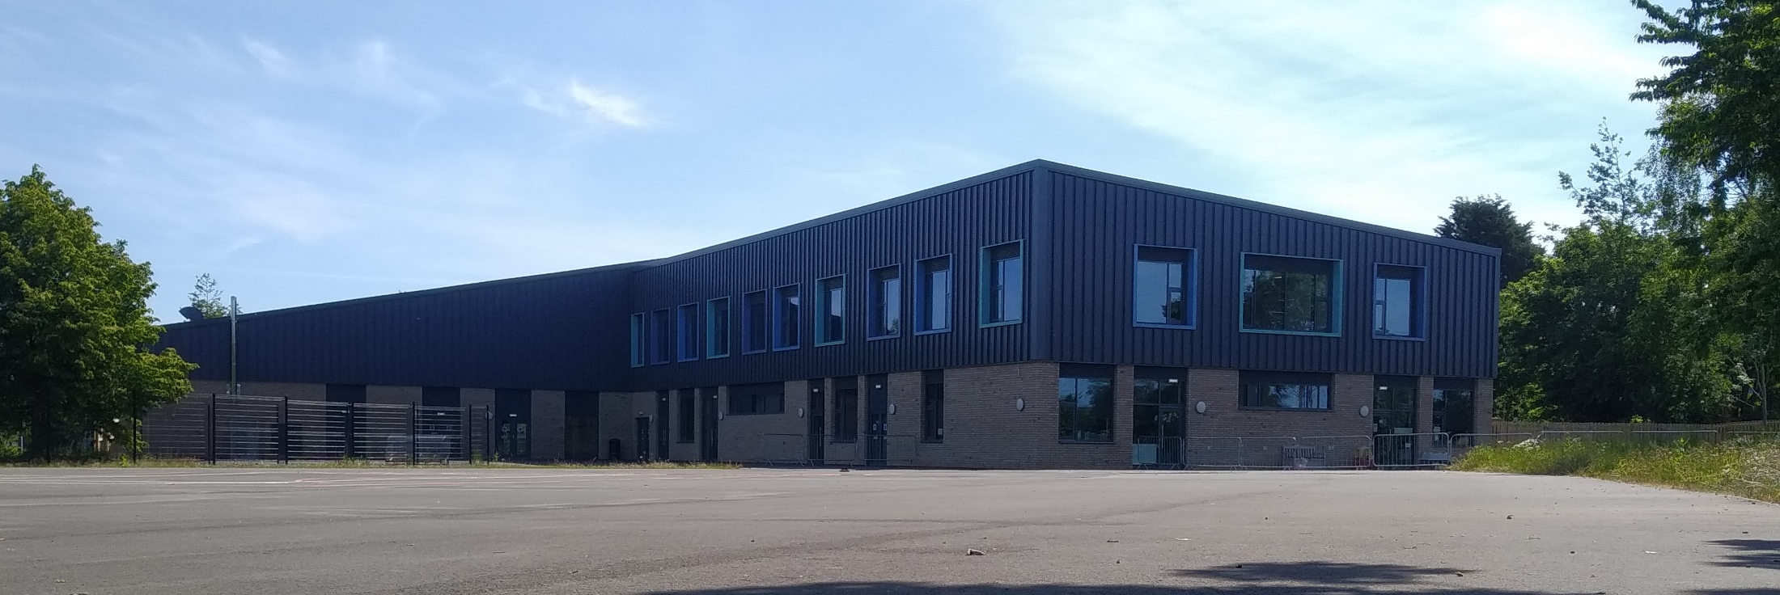

Welcome to Reception Class
‘Love, Learn, Live’
June 2021

Slide 2
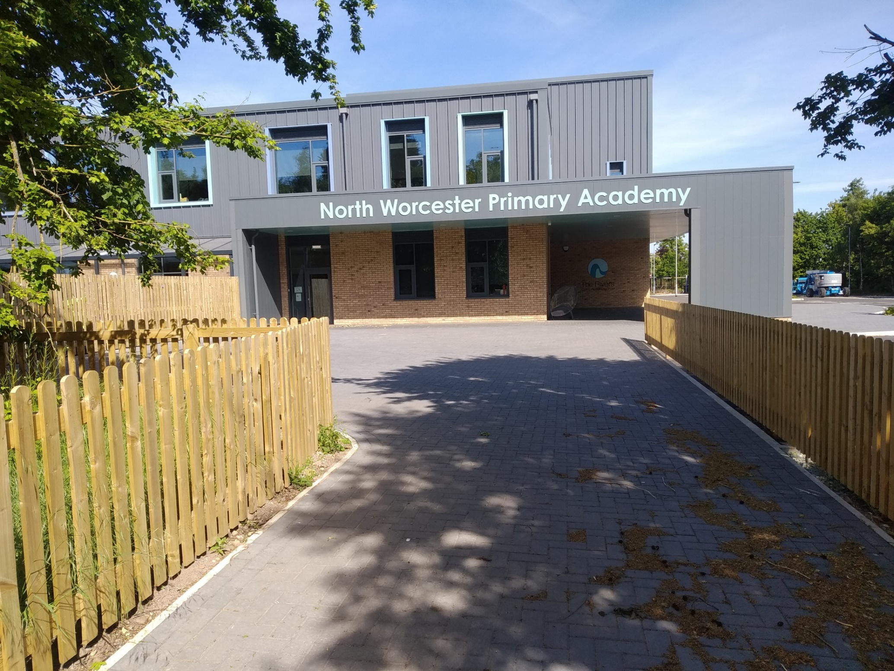
This is how you come into school. Walk towards the building.

Slide 3
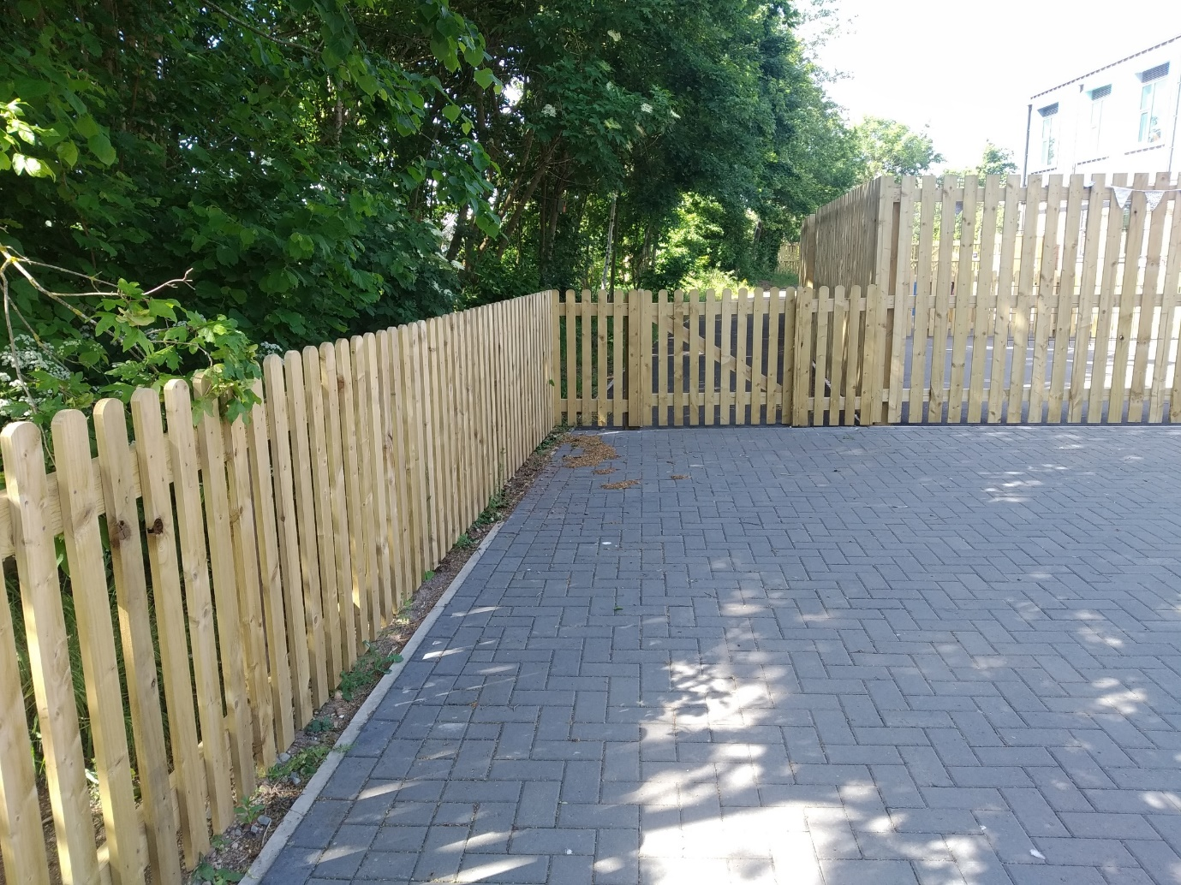
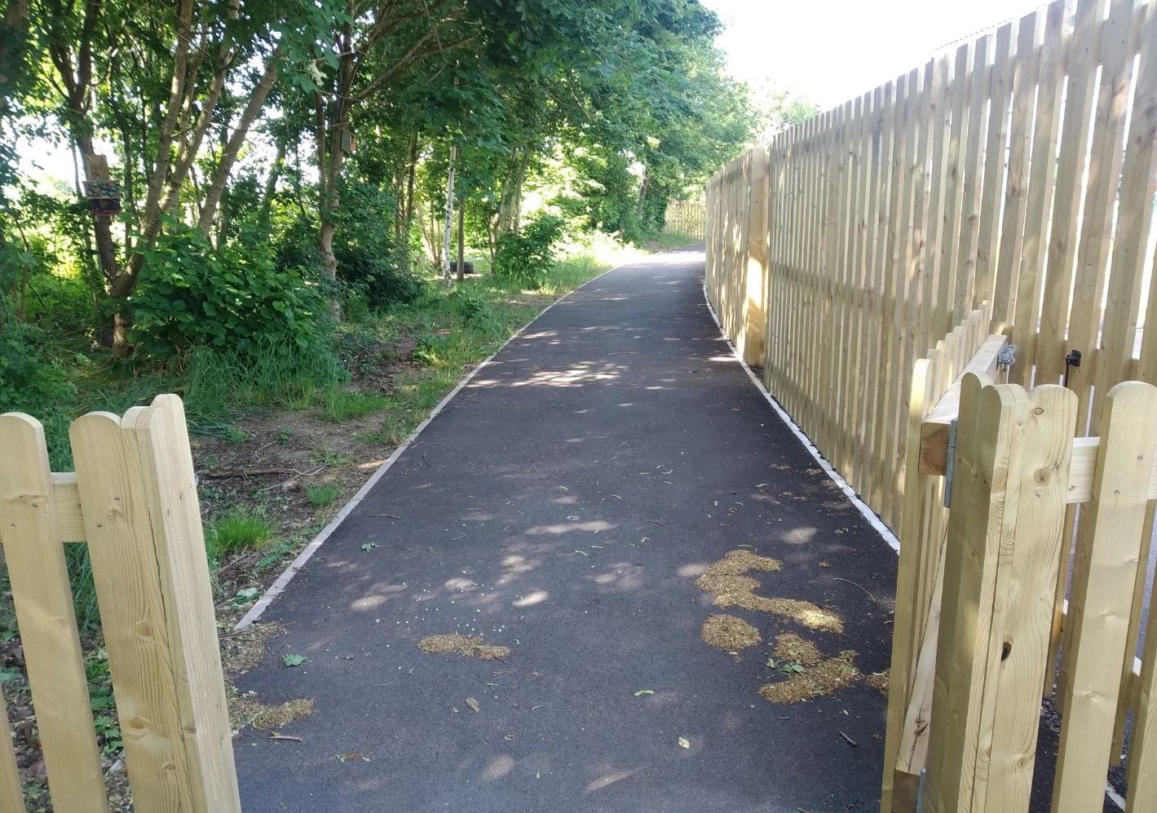
Then turn left and walk through the small gate.
Follow the path past our forest school.

Slide 4
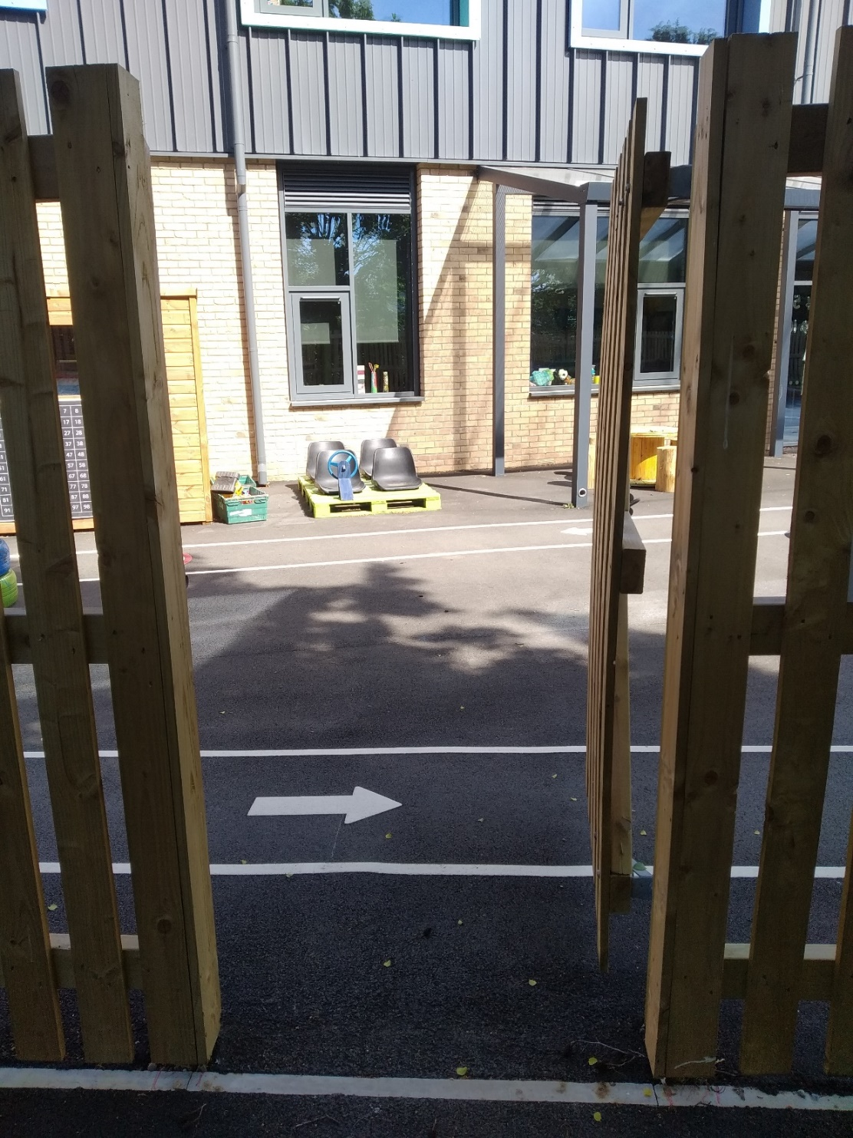
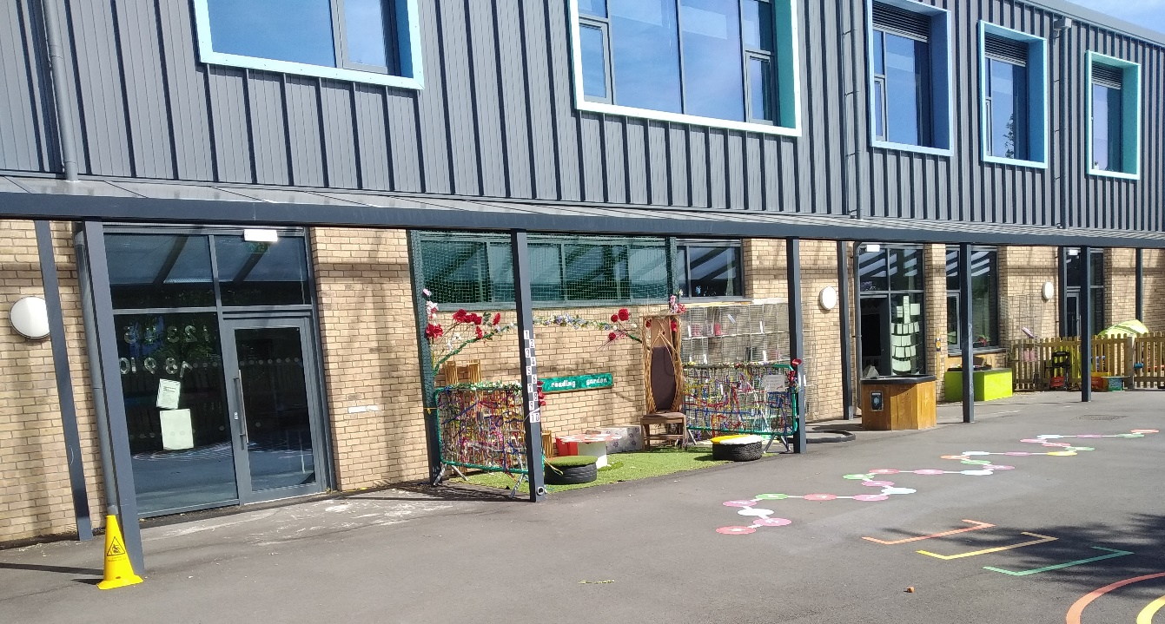
Turn right into our Reception playground. There are two classroom doors in front of you.
Your teacher will be waiting for you, with a big smile!

Slide 5
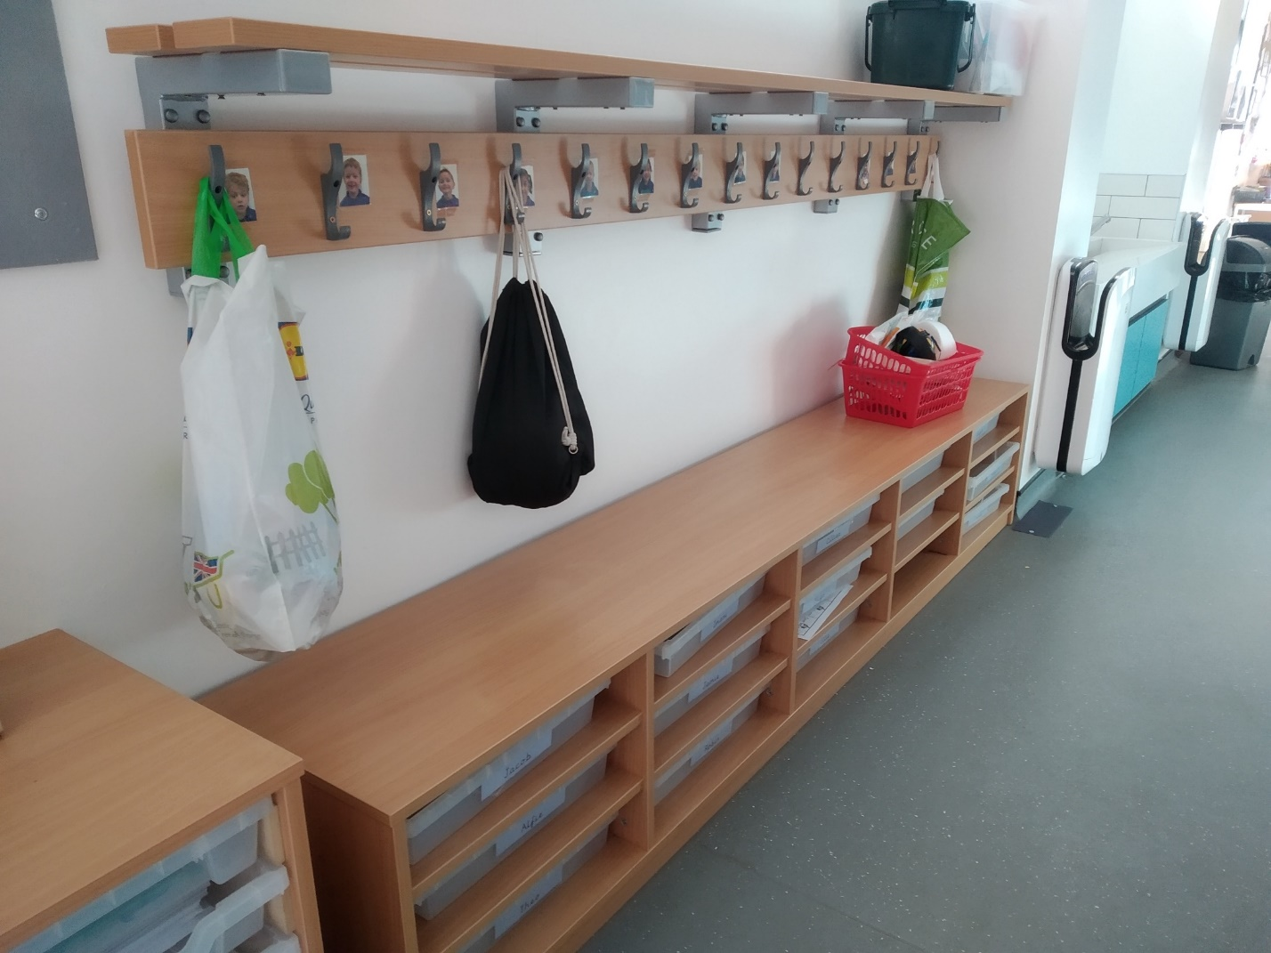
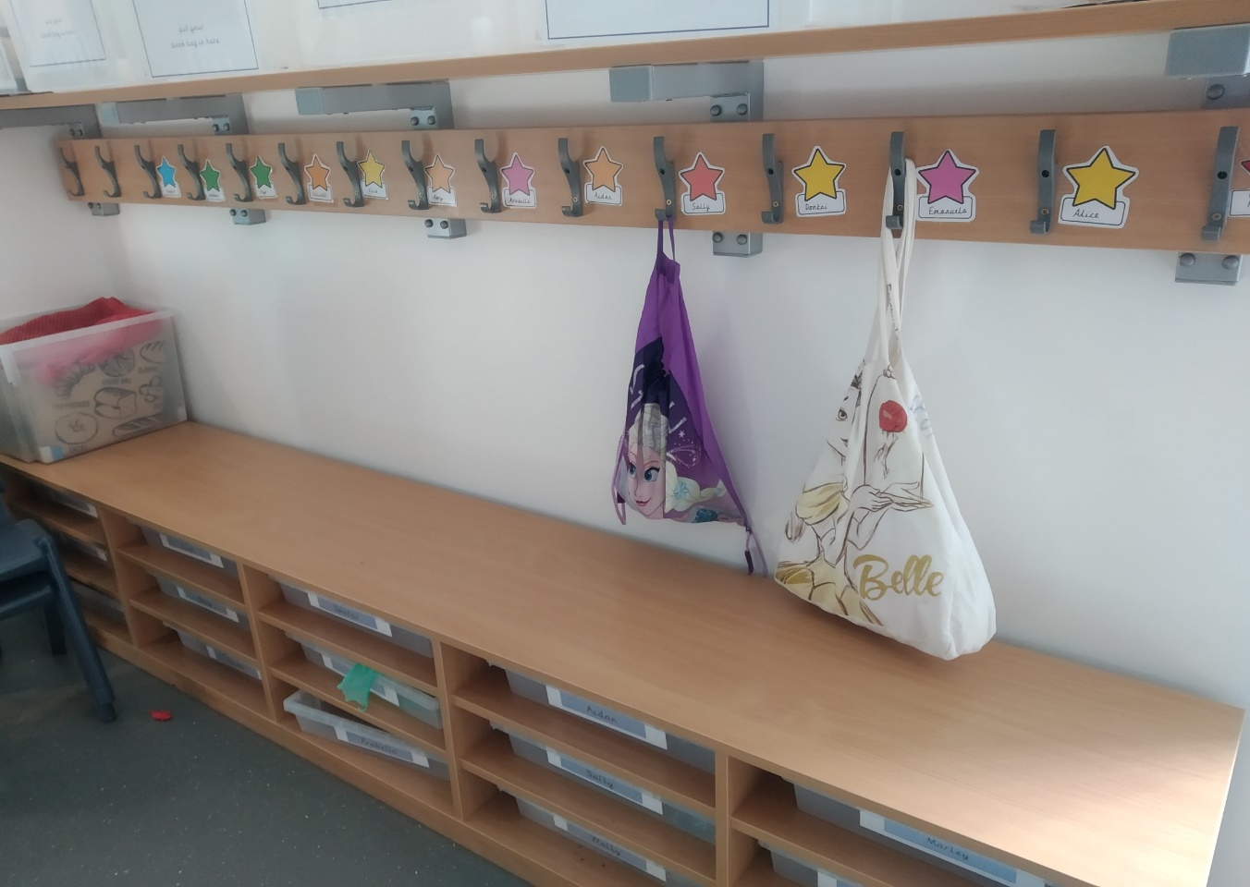
In both classrooms there is a place to hang your coat, your PE kit and your wellies. It will have your name next to it so that you know it is your peg.
There is a tray underneath to put your book bag.

Slide 6
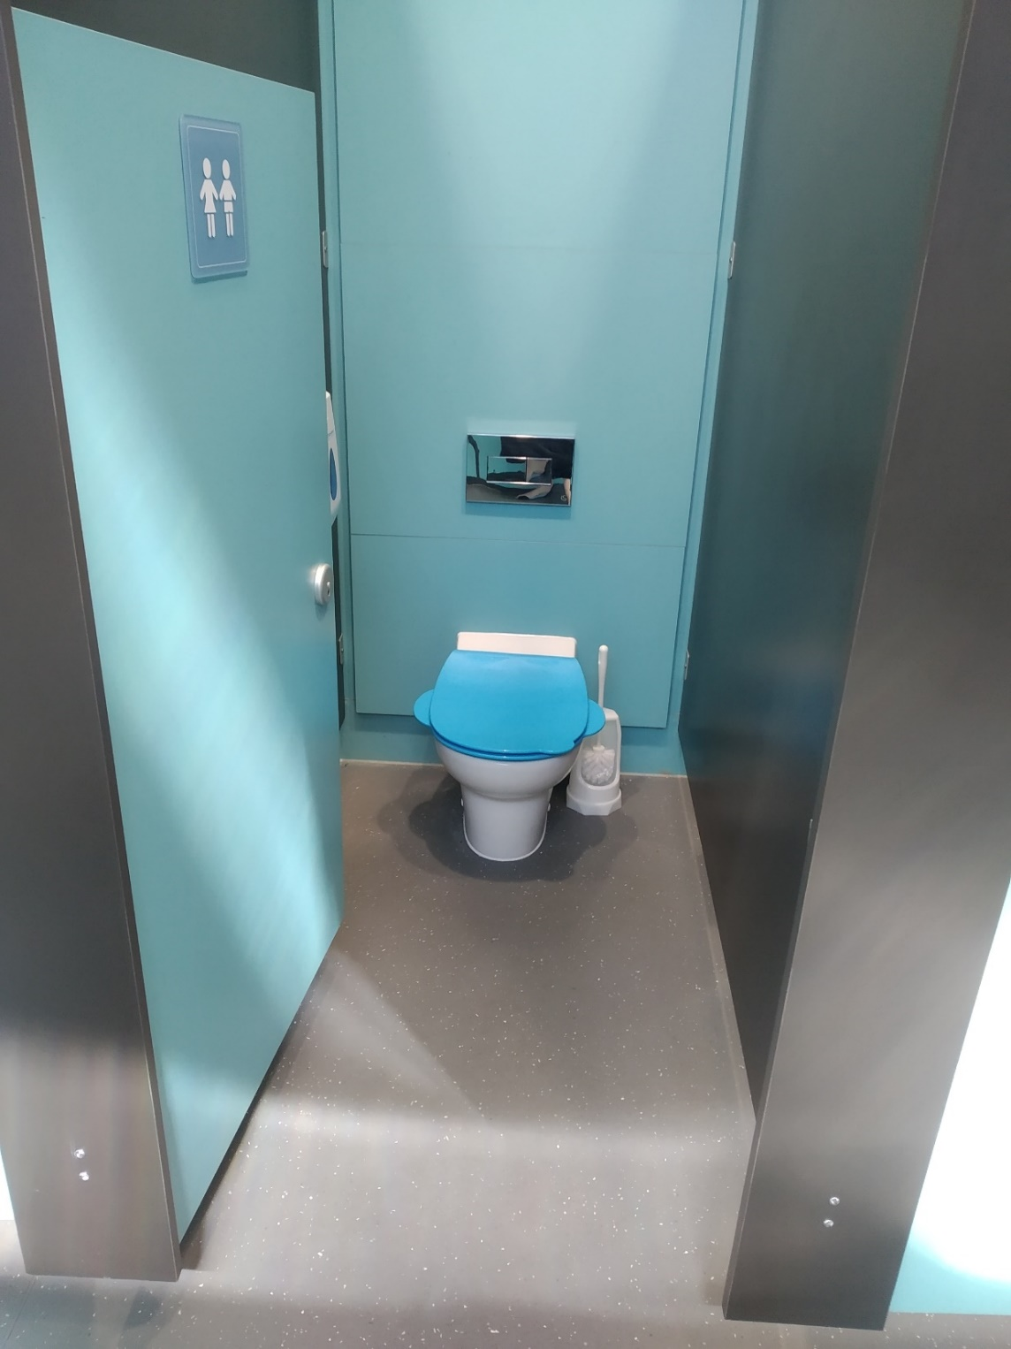
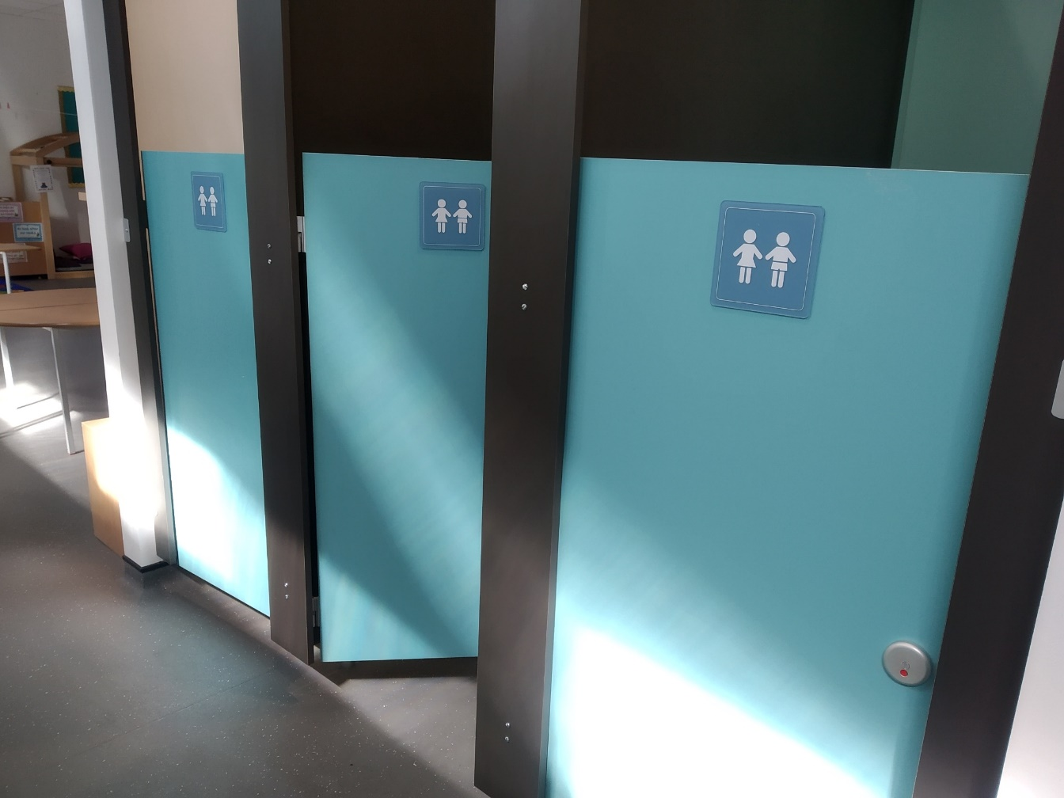
There are three special toilets in Reception. They are special because they are just the right size for you!

Slide 7
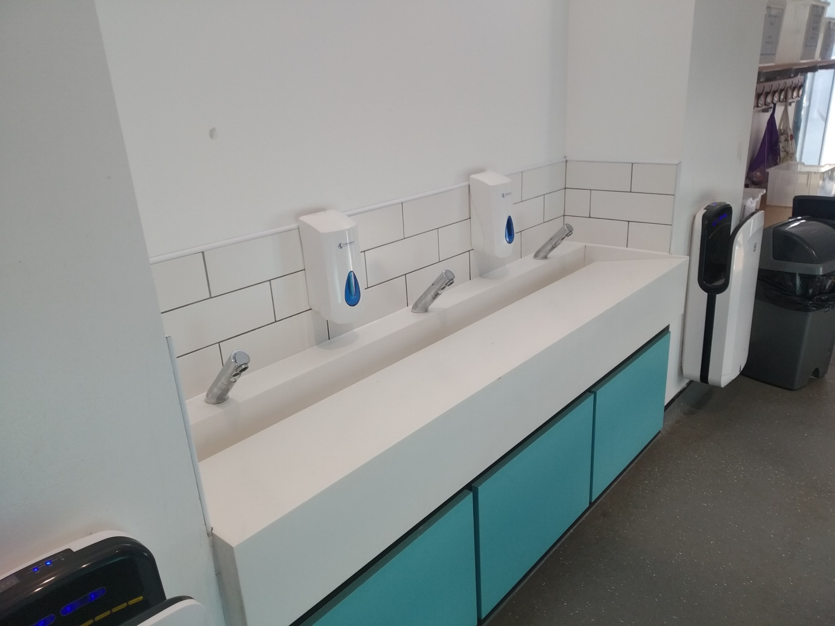
Opposite the toilet, there is a lovely place to wash your hands.
Washing your hands is very important!

Slide 8
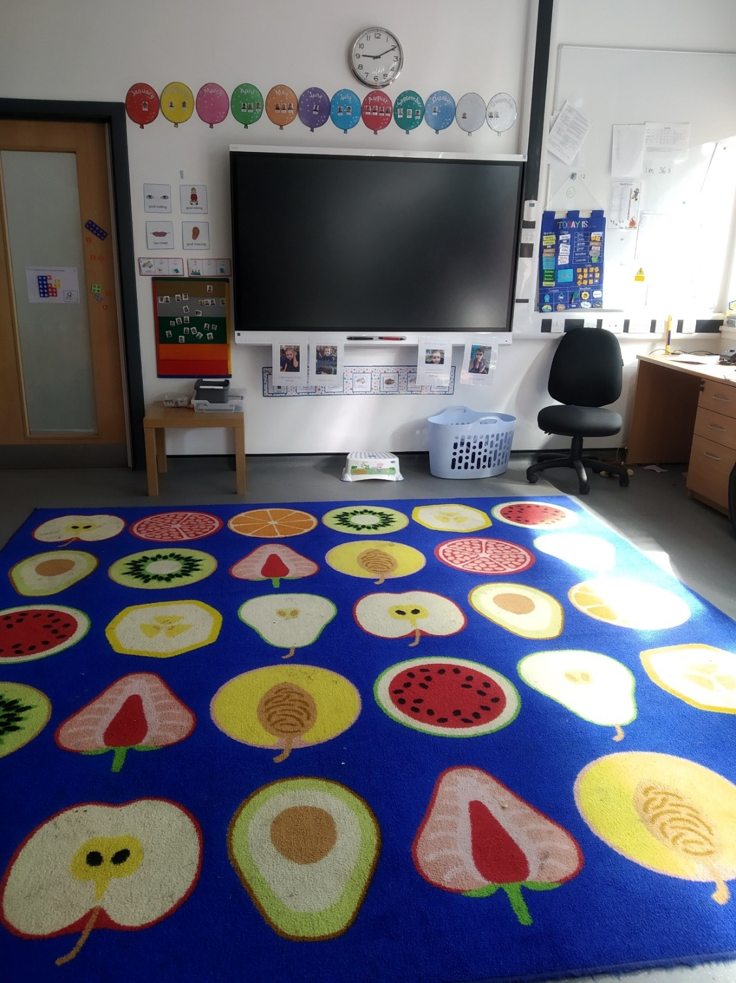
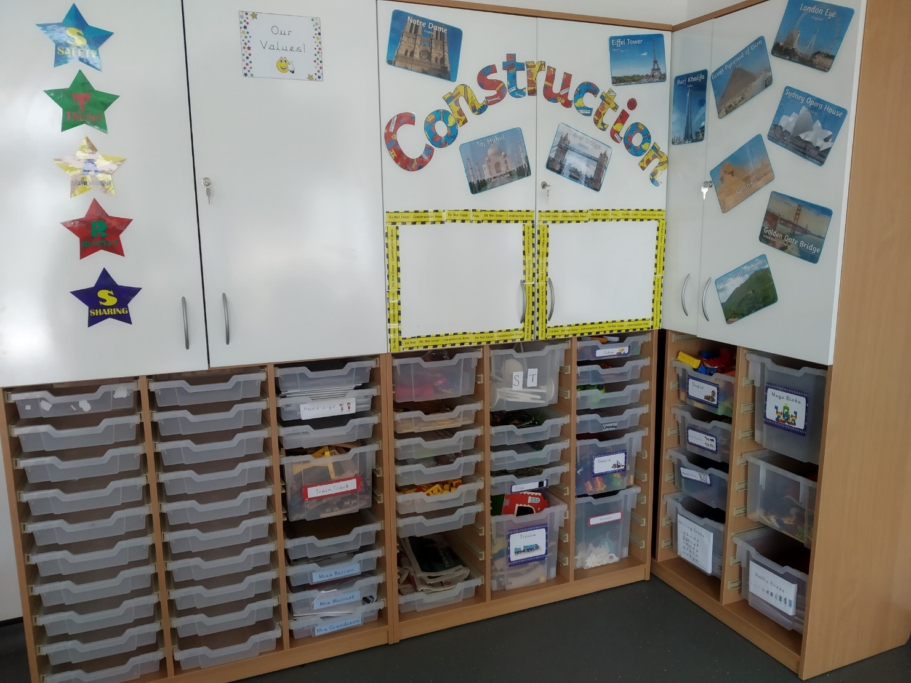
Our classrooms are bright and colourful places.

Slide 9
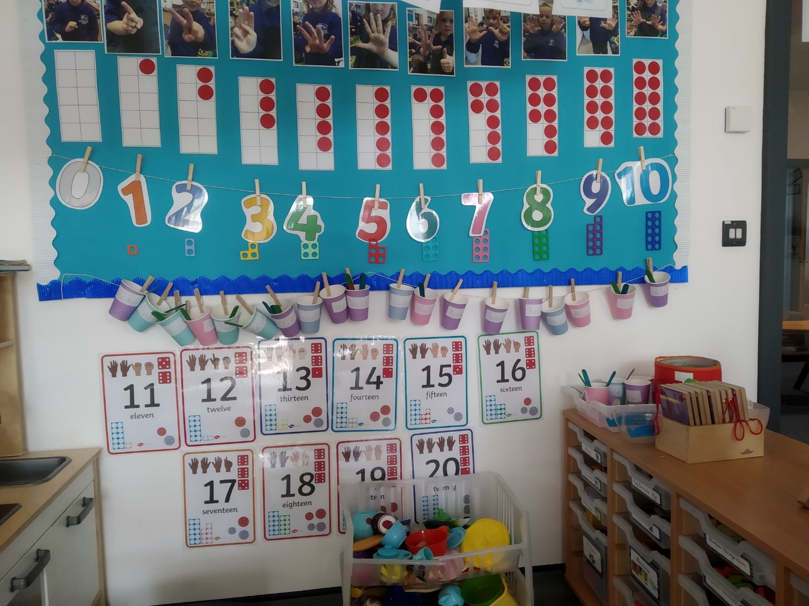
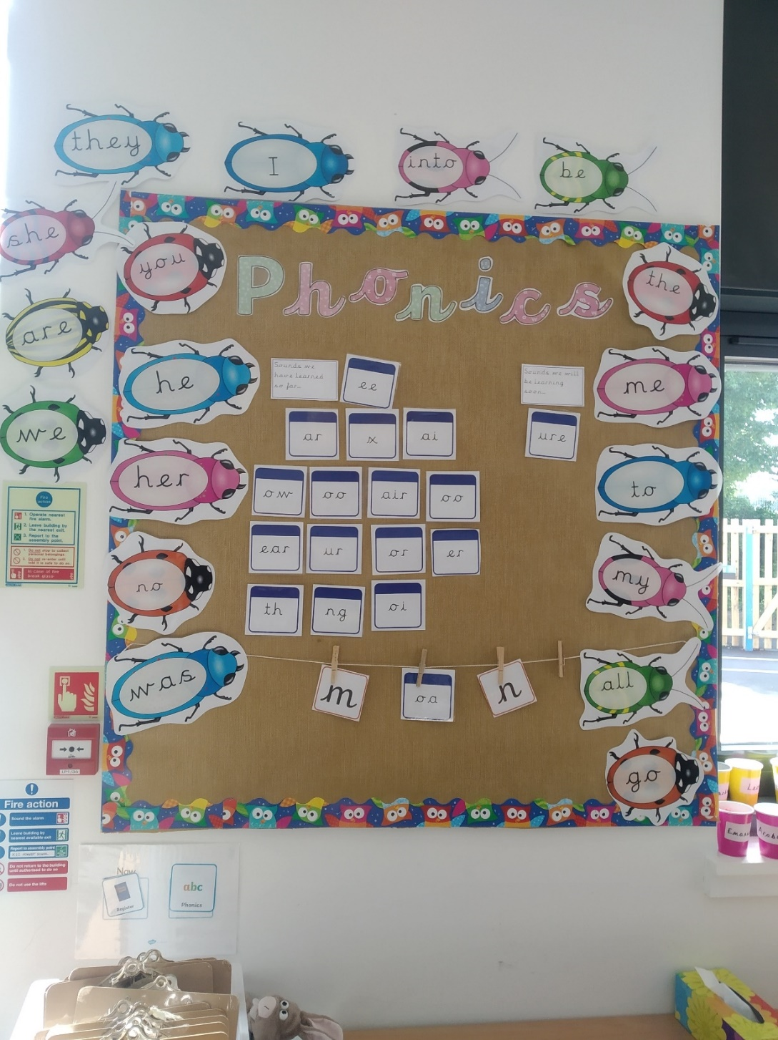
There are lots of displays to help you learn.

Slide 10

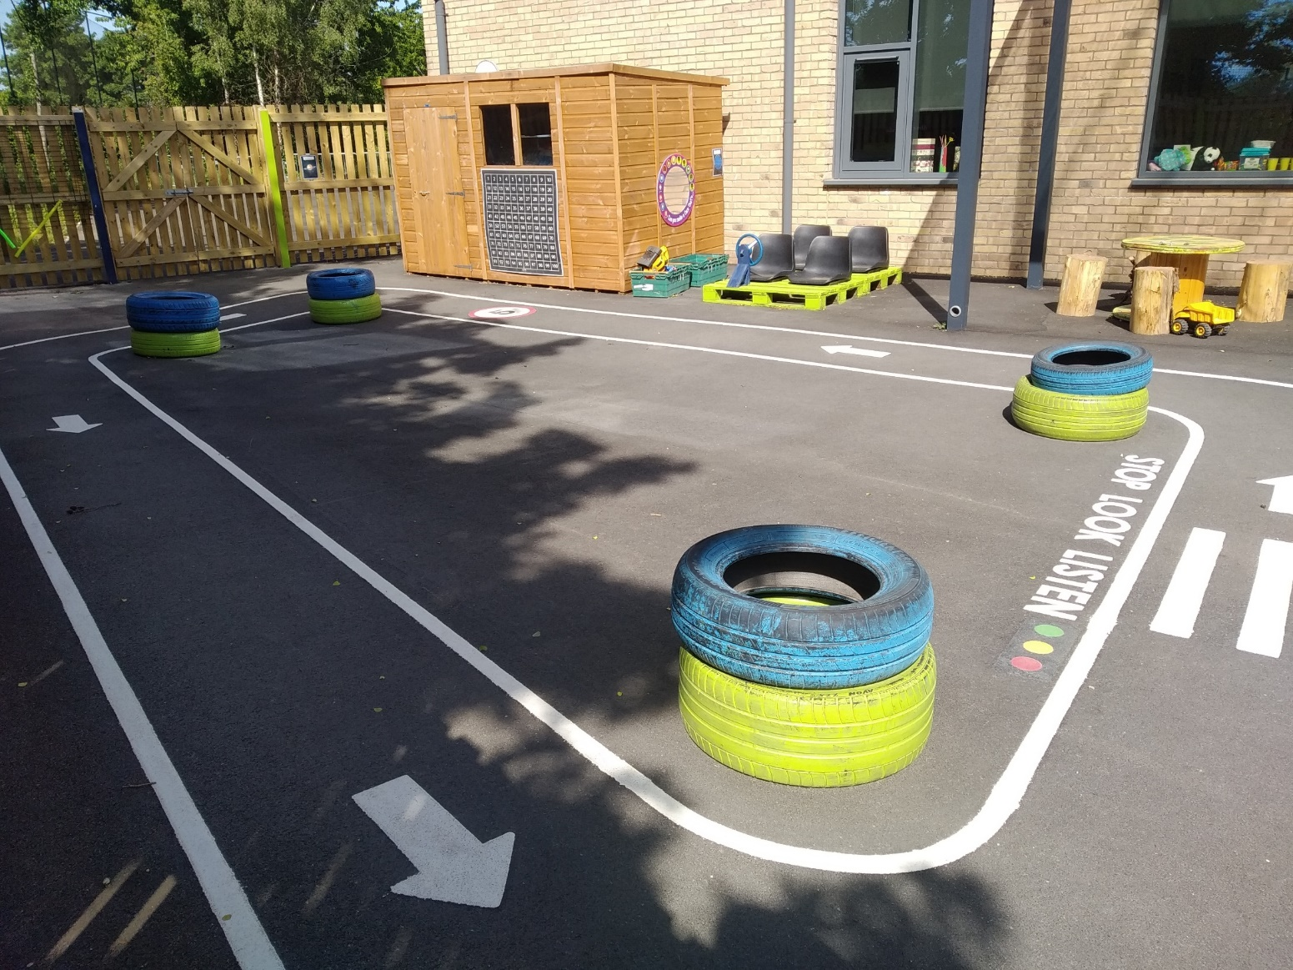
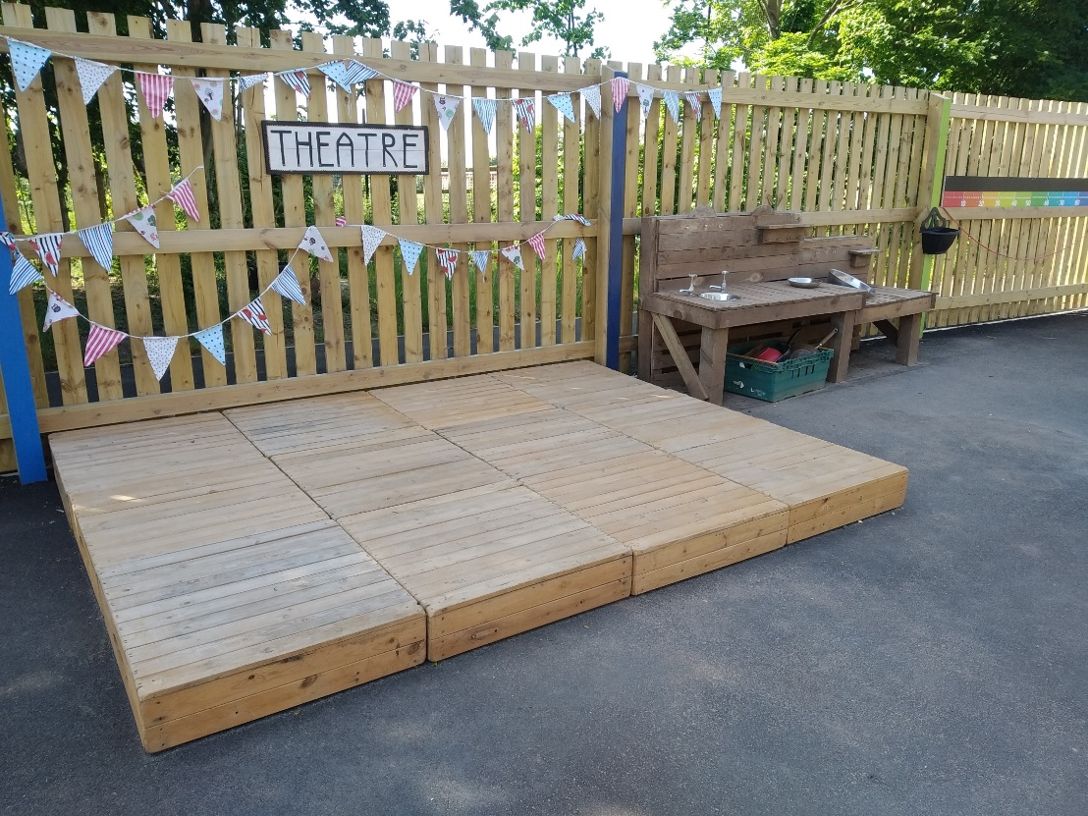
There are lots of fun areas to play and learn in outside.

Slide 11
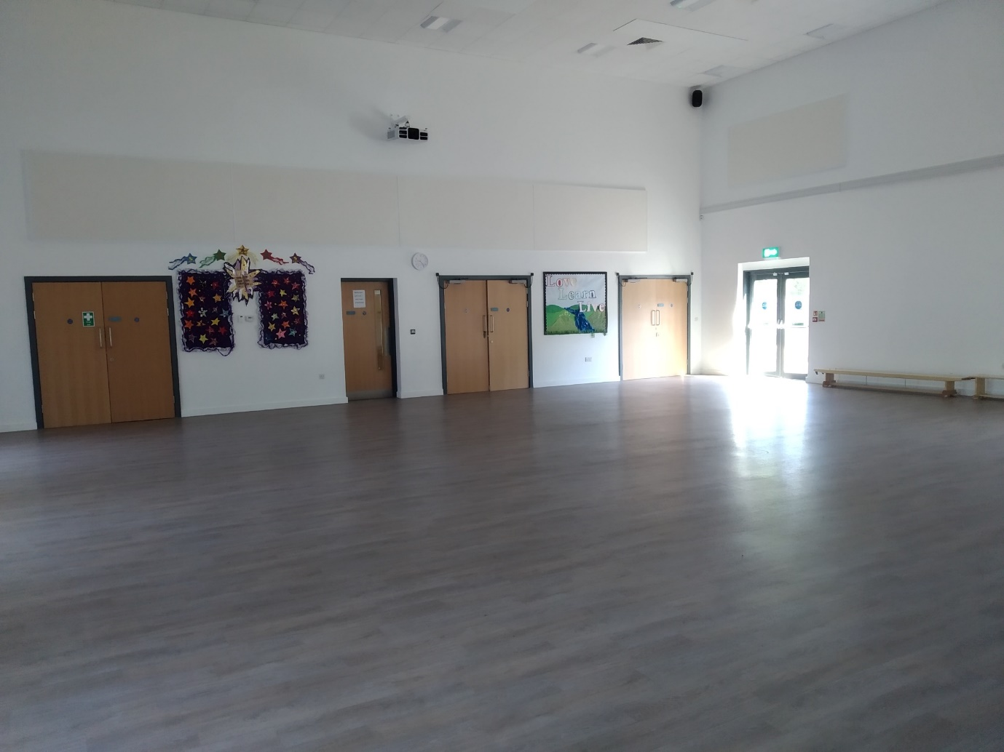
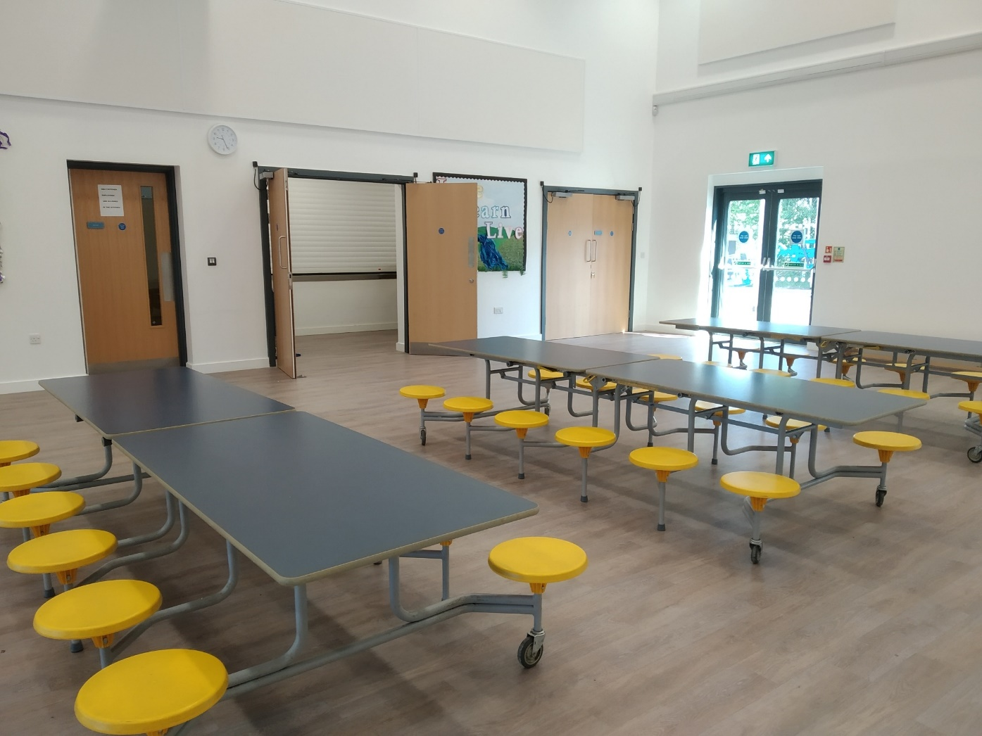
We have a beautiful school hall. Sometimes it is empty when we use it for assembly or PE.
Sometimes there are tables for you to eat your lunch or to enjoy big art projects.

Slide 12

At the end of the day, two things might happen.
Either your grown up will wait outside to collect you and take you home or you will be taken into after school club to play until your grown up picks you up.

