Slide 1
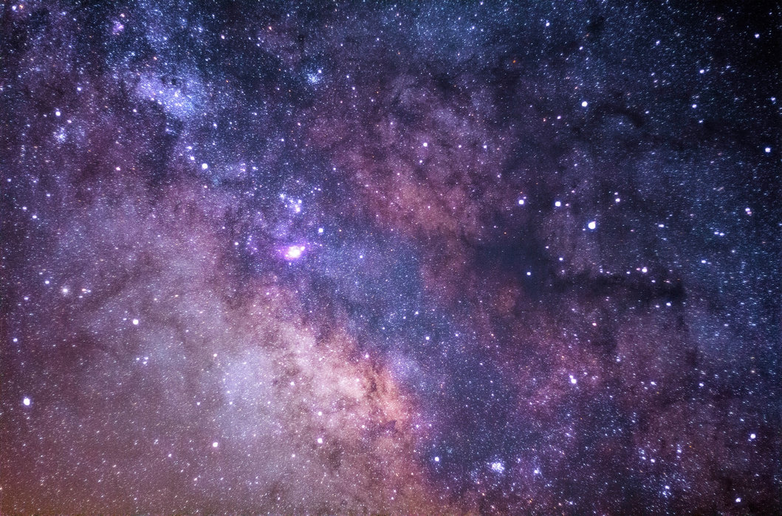
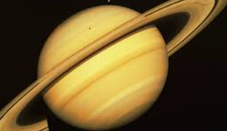
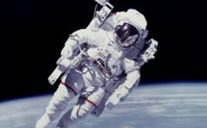
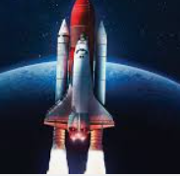
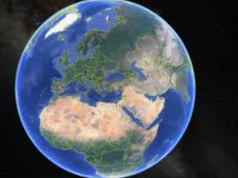
Communication and Language
Learn key words relating space and planet Earth
Listen to stories and recall main events
Use language to discuss and share thoughts, ideas and experiences of their own
Use lengthy sentences to help develop understanding, ask questions and include new vocabulary in speech
Use topic related word maps to support learning and help identify key words
Utilise ‘Topic Table’ in class to support understanding
Personal, Social and Emotional Development
Use equipment to help support own learning i.e. paintbrushes, pencils, spades etc.
Share own prior knowledge of space and related objects i.e. telescope
Share prior knowledge with peers during Circle Time and small group work activities
Discuss how it might feel to travel to space. Listen to and watch accounts from real-life astronauts and think about life in the Space Station.
Physical Development
PE and dance
Forest School
Copy movements, such as walking on the moon.
Use physical skills to build towers and structures i.e. rockets
Select resources appropriate to their task
Tracing and pencil control sheets
Cosmic Yoga
Mathematics
Whole class interactive maths games on the Smartboard
Explore shape and pattern through the creation of shape rockets.
Use mathematical language when talking about patterns i.e. names of shapes and positional language
Develop recognition and witing of numerals through space themed maths activities.
Develop IT skills (interactive maths games)
Space
Pre-School’s next topic of ‘Space’ is aimed at supporting children’s knowledge and understanding of the world and life around us. The class will look at varying aspects of space, including; planets, the sun and stars. As well as considering how people travel to space and the role of an astronaut. Children will have the opportunity to engage in a wide variety of activities, which incorporates daily sensory activities, bright colours, texture and imaginative play.
Expressive Arts and Design
Develop use of mixed media to create space related art and 3D models.
Mix and experiment with colours
Create own art and pictures based on images of space and Earth
Use playdough to copy patterns and shapes
Use the role play area to invent games and re-enact experiences
Learn songs about space.
Literacy
Understand that print carries meaning, through the reading of stories and non-fiction books.
Participate in Phonics sessions in order to learn and practice Initial Sounds
Build vocabulary through listening to and engaging with Class Read, as well as the use of flash cards and pictures.
Practise witing own name using name cards
Use topic-related language to name items found in space.
Understanding the World
Use Google Earth to look at our planet
Develop IT skills through using IT (iPads and Smartbard)
Discuss space, planets and stars.
Watch topic related clips, in order to provide visual reference and talking points.

