Slide 1
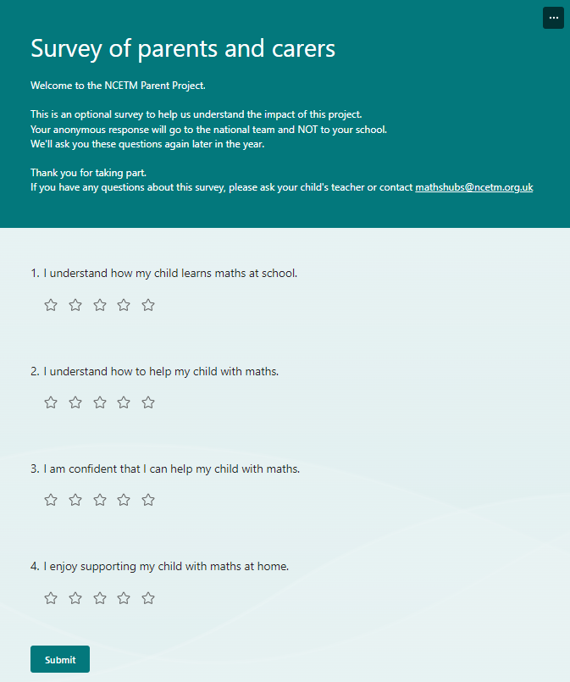
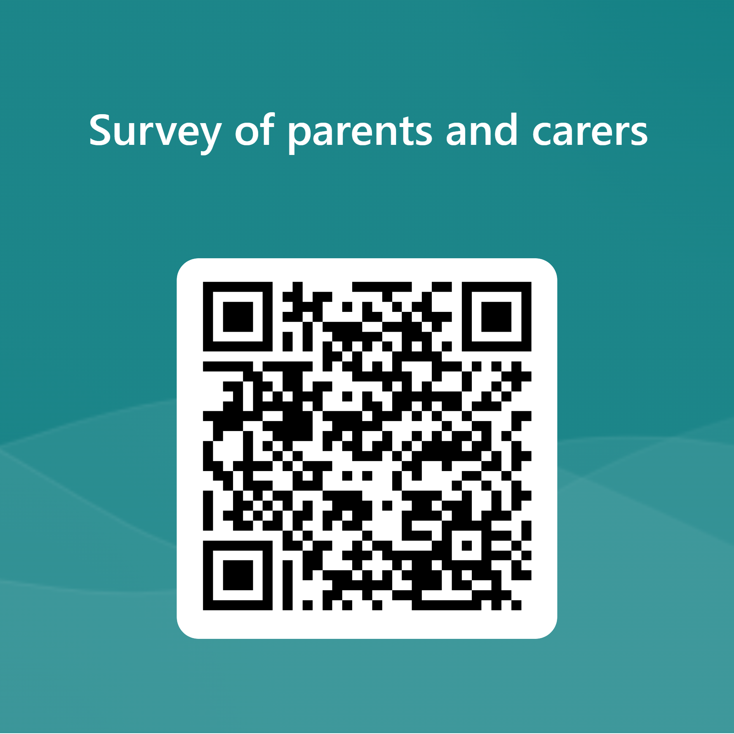

Survey for parents and carers – start of workshop
https://forms.microsoft.com/e/bp53TFNTK0
This is a short, optional, anonymous national survey to help us understand the impact of this project.
We'll ask these questions again later in the year.
Thank you for taking part.
If you have any questions about this survey, please ask your child's teacher or contact mathshubs@ncetm.org.uk

Slide 2

Mastering Number at Home
Year 1
Notes:
The first ten minutes of the workshop are for parents only. It is to set the scene and offer the rationale for engaging with them in their children’s learning.
The first seven slides are designed for use with parents only. Their children should join them for the subitising activity on slide 10.
Most of the home learning resources will be introduced and ‘tried out’ in the live session with parents. So that you can do this, please have the following printed off/ready for use in the workshop:
Prior to attending, please inform grown-ups that they will need to bring an egg box (for 6 eggs) to the session. You could start collecting these in school in the weeks leading up to the workshop.
An egg box for 6 eggs
14 two-coloured counters (The children will need to keep these and take them home after the session)
2 dice frames
The digit cards for 6
A large box of objects – enough for all children to have 6 each – cubes, pebbles, marbles, coloured counters etc. – NOTE: These need to fit into the spaces in the egg box
Scissors – one pair for each supporting grown-up. These are for use in the session only and are not to be taken home.

Slide 3
Aims of the session
To share with you some of the things your child will be learning in school
To improve your confidence in helping your child with maths
To create some games and activities for use at home
To share with you the home learning activities

Slide 4
Why work with your child?
The help that parents give their children at home has a very significant impact on their learning.
Development Matters (2023)
Notes:
Point out to parents that research proves that high quality teaching in school is key to raising attainment. But their role is also really important!
If parents understand how their children are being taught in school, then this can have a dramatic impact on children’s outcomes (and confidence), even in schools that are already successful.

Slide 5




How does Mastering Number help us to teach maths in school?
The Mastering Number Programme in Year 1 will help your child to develop good number sense.
Some of the things they are learning include:
Recognising small numbers of objects without having to count them
Know different ways to ‘make’ (compose) a number
Notes:
The MN Programme is a new national programme based on research into what is important in early maths education.
‘Number sense’ includes lots of things; the things mentioned here are some of them, but we are only going to focus in this session on the second two.
It is worth mentioning to parents here that the numbers children use may be smaller than what they can do at home, but we are purposefully focusing on smaller numbers so that the children can develop a deep understanding of numbers to develop that good number sense.
Children will be learning gradually to count out larger sets of objects and join in with the counting numbers, but to have a really good foundation to build on, the smaller numbers are so important.

Slide 6

How do we develop good number sense?
Knowing how numbers are ‘made’ will help children later on with calculations.
I know that 6 is made of 4 and 2 so I will also know...
6 - 2
60 - 20
40 + 20
0.4 + 0.2
400 + 200
0.6 - 0.2
Notes:
Teachers can point out that the deeper understanding helps children in their learning later on in school. The example should be shared with parents.
Children who develop good number sense in Early Years and Key Stage one are much more confident and capable in maths later on.

Slide 7


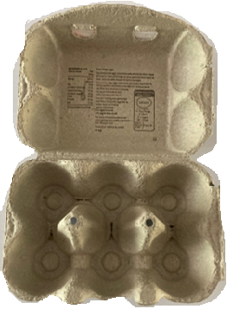
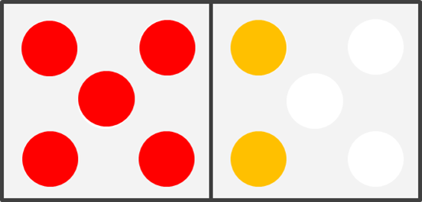
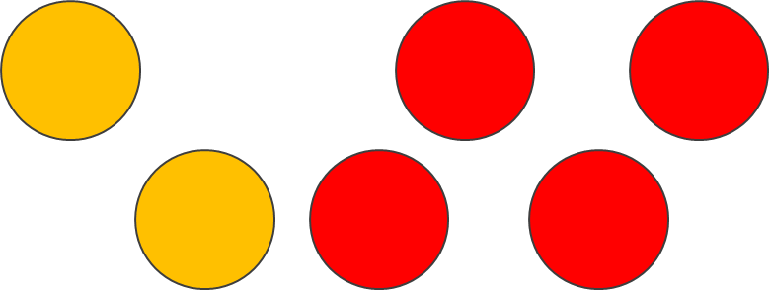
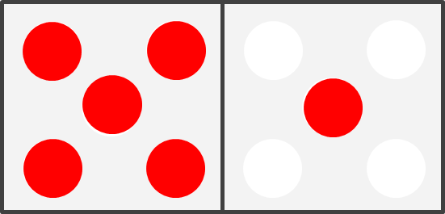
Let’s look at 6 and 7!
Finding all the ways that 6 and 7 are ‘made’ and then doing activities that give them a chance to practise will help children.
Notes:
We are going to look at all the different ways of making six and seven – using lots of engaging activities and games.
We want parents to realise that supporting this work can be easy and there are lots of opportunities to do this at home.
We will start with subitising, as it is the foundation for this learning and parents are unlikely to have seen/used it before so need to become familiar with how their children are composing the numbers.

Slide 8

Recognising small ‘numbers’
For all of the activities you will be doing at home, we want children to use a special skill called ‘subitising’.
Get your fast eyes ready!
Show on your fingers and tell your grown-up how many dots you can see!
Notes:
The children should now be invited to join their grown-ups.
You might want to prompt adults to think about what we are meaning here by ‘numbers’.
Rather than explaining what subitising is, we are going to have a go at it.
In a moment, I will flash an image on the screen with some dots. Adult and child should agree how many dots there are - children can also use their fingers to show the amount.
Get your fast eyes ready, as it will only appear for a second or two.
Let’s have a go at ‘subitising’ – can you say how many things you can see?
Show next slide for 2/3 seconds.

Slide 9
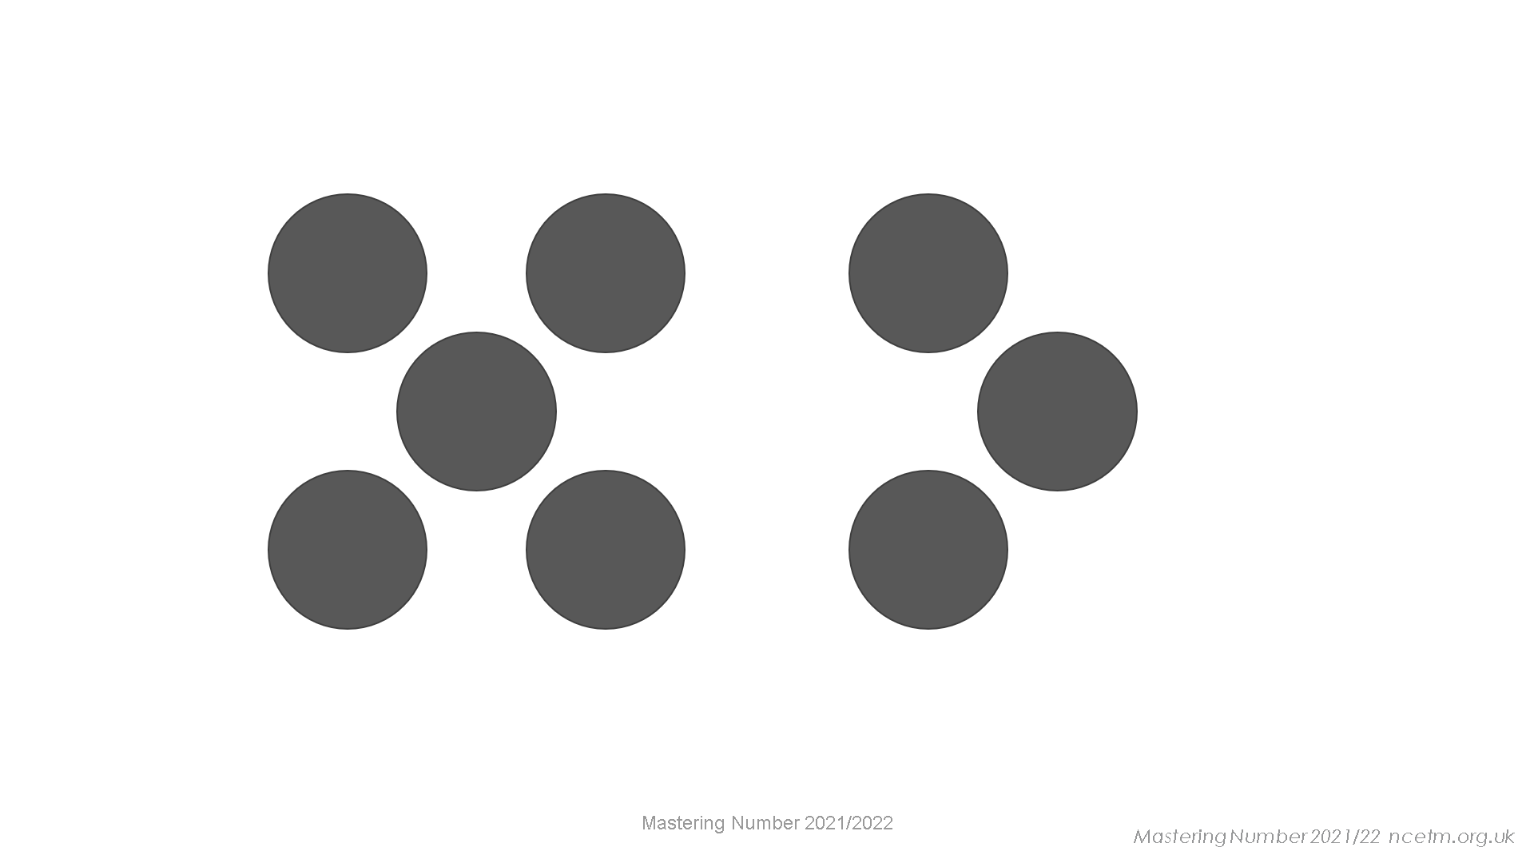

Slide 10
Notes:
Did you need to count? Of course not - we can all see that was 2!

Slide 11
Notes:
Did you need to count?

Slide 13
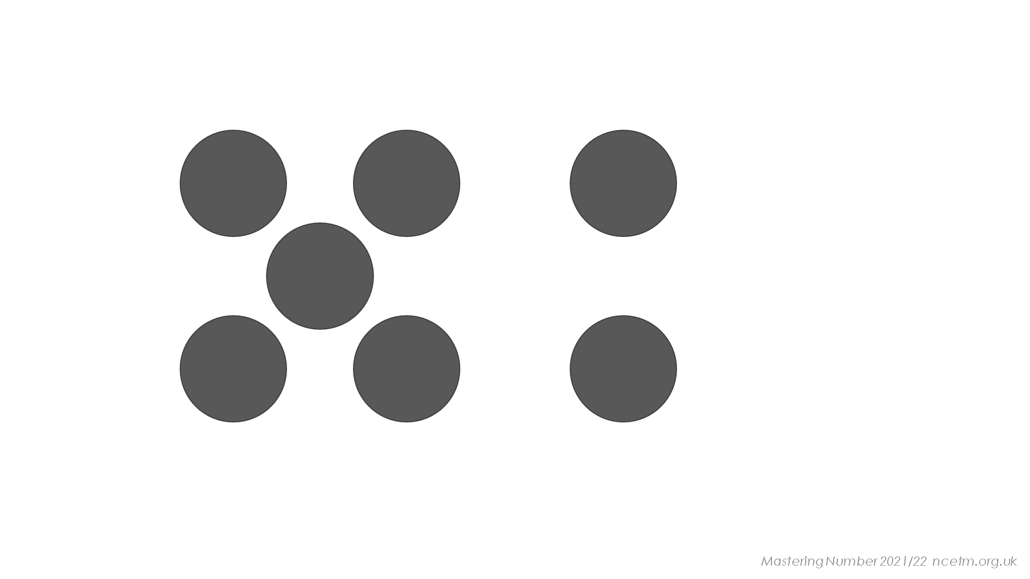
Notes:
What helps you to see four here?
Tell your grown-up where you have seen this four before.

Slide 15
Mastering Number 2021/22 ncetm.org.uk

Slide 17
Mastering Number 2022/2023

Slide 18
Notes:
Again, tell your grown-up how you know that this is five.

Slide 19
Notes:
What helps you to see six here?
The dice representations are a useful support that children become used to recognising. It’s also important that they can recognise the amounts when they are not in the dice patterns.

Slide 20
Home learning tasks
Each week, you will be given a sheet that explains some activities that children can do with their grown-up.
In Year 1, the tasks will all be about finding ways to make 6 and 7, but these tasks could be used for other numbers later on.
In all of the tasks, children should be encouraged to ‘see’ the amount of objects without counting – just as they did in the previous activity.
Notes:
Now we will look at some of the tasks that we will ask you to do with the children.

Slide 21
Play ‘Drop the counters’
You will need 6 double-sided counters to play.
6 is made of _____ and _____;
_____ and _____ make 6.
Week 1
Notes:
Explain what will be needed and do a quick check to ensure all groups have the resources ready in front of them.
Explain the importance of the stem sentence to grown-ups. They are not just there as a prompt for the children; there is evidence to show that when children say the sentences, they remember the maths better.
Remember that children should subitising the sub-groups/ i.e. how many of each colour.

Slide 22
6 is made of 4 and 2;
4 and 2 make 6!
Play ‘Drop 6 counters’ with a grown up! How quickly can you say what you see?
6 is made of _____ and _____;
_____ and _____ make 6.
Mastering Number 2021/22 ncetm.org.uk
Notes:
Teacher – talk this through as you progress through the slide to demonstrate the activity.
Children take it in turns with the grown-up to hold the counters in one hand and ‘drop’ them onto the table (or tray if possible). Look at the numbers that the two colours show. Use the stem sentence to show the bond that you have ‘dropped.’
Remind grown-ups of the importance of stem sentences and how research suggests that they really help to reinforce learning. When it is the grown-up’s turn, it is also important that the grown-up says what their bond is as a ‘model’ for their child.
Allow them to have a few goes at this, using the stem sentence each time.

Slide 23
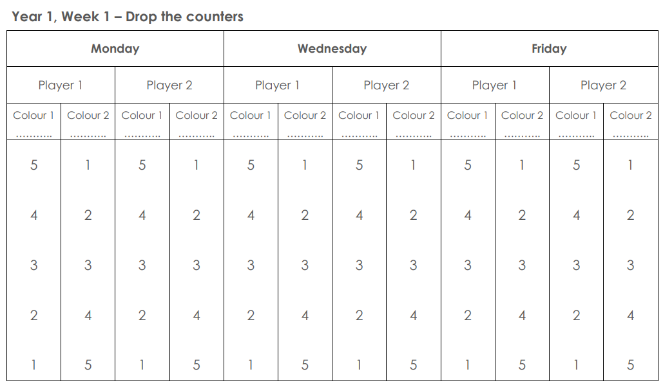
red yellow
Week 1
Notes:
Explain to grown-ups that, in the home learning sessions for Week 1, they will have a Drop the counters record sheet.
They need to play this on Monday, Wednesday and Friday.
They have the columns for player one and player two and a space to write the counter colour down for each ‘drop’ they make.
Click mouse: shows where to write the colour (this is in case the colours of the counters you have purchased are not the same as those shown on the slides).
2nd click – this shows that if player one drops 4 red and 2 yellow, these are the numbers on the list for them to circle.

Slide 24
Play ‘Egg Box 6’ with counters
Use your stem sentence strip again, this time using your egg box and counters.
6 is made of _____ and _____;
_____ and _____ make 6.
Week 1

Slide 25
Let’s work in order to find the ways to make 6.
6 is made of _____ and _____;
_____ and _____ make 6.
Notes:
You might choose to explain that working in order is called ‘being systematic’.

Slide 26
Place all counters red side up
How many yellow counters?
How many red counters?
Notes:
Ask grown-ups/children to place 6 counters in the egg box with one colour showing. Use the speech bubbles so children can answer the questions.
Grown-ups should confirm this: ‘You can see there are 6 red counters and no yellow counters.’
Teacher: We are going to work systematically to find all the ways that 6 can be composed, using the counters.

Slide 27
Turn over one counter at a time so you can see the yellow side
6 is made of 1 and 5;
1 and 5 make 6!
6 is made of _____ and _____;
_____ and _____ make 6.
Notes:
Ask the child to turn one counter over and say how many yellow and how many red counters there are.
Six is made of one and five. One and five make six.
Once the children have noticed this way of making six, grown-ups might shut the box. Can you remember the bond we have made? How quickly can you say the bond when we reopen the box?
The stem sentence should be used to consolidate understanding.

Slide 28
6 is made of _____ and _____;
_____ and _____ make 6.
Notes:
Six is made of two and four. Two and four make six.

Slide 29
6 is made of _____ and _____;
_____ and _____ make 6.
Notes:
Six is made of three and three. Three and three make six.
Continue working systematically until all yellow counters are showing. Explain to the grown-ups that, when doing this activity at home, the children can turn any of the counters over and do not need to work in the same way that we have here. This will help them to see the bonds in different arrangements.

Slide 30
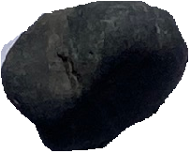
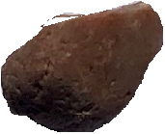
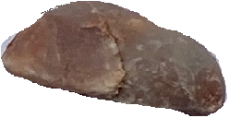
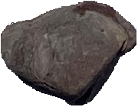
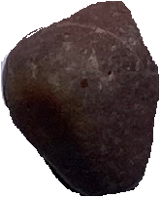
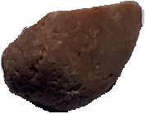
Play ‘Egg Box 6’ with objects
Gather 6 objects that can fit in the spaces in the egg box.
Week 2
Notes:
In the workshop, children can use any objects from the classroom for this task: cubes, counters, marbles etc.
Encourage them at home to find things that they can use for the same activity there – i.e. collecting acorns or conkers on a walk, 1p coins or using buttons, pebbles, marbles etc.

Slide 31
Put some of the objects in the egg box and hide the others.
How many more to make 6?
_____ needs _____ to make 6.
Notes:
The grown-up should put some objects in the egg box and hide the others.
Using the objects and the gaps left behind, can your child work out how many more are needed to make 6?
The stem sentence will support understanding here.

Slide 32
Play this again using different numbers of objects.
_____ needs _____ to make 6.
Notes:
Allow some time for the families to play several games of this.

Slide 33
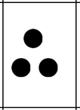
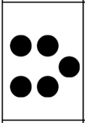
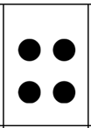
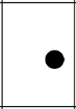

Find pairs to 6 with dots
Cut out the cards and place them face UP on the table in front of you.
Week 2.
Notes:
Note to teacher.
For the workshop, it would be useful if the grown-ups only cut out the first three rows of these numbers. The others can be cut out and added to the game at home.
You may wish to only provide the first three rows for the workshop to avoid parents spending time cutting them all out.

Slide 34
Play: ‘Find pairs to 6’ with dot cards
Let’s practise remembering the ways that 6 can be made.
Week 2
Mastering Number 2021/22 ncetm.org.uk

Slide 35
Find pairs that make 6.
One person will pick up a card, and the other person must pick up the card that will ‘make 6’.
Use the stem sentence to support.
_____ needs _____ to make 6.
Week 2: In Week 4, children will find pairs of numbers that make 7 with dots.

Slide 36

Play ‘Copy my 7’
You will need two of these for this activity.
Week 3
Notes:
Ask grown ups to find the two dice frames in their resource pack. The grown-up and child will need to have one of these each. They will also need 7 two-coloured counters each for this activity.
We are going to look at placing 7 counters on the frame in different ways. Can your child copy your pattern accurately?

Slide 37
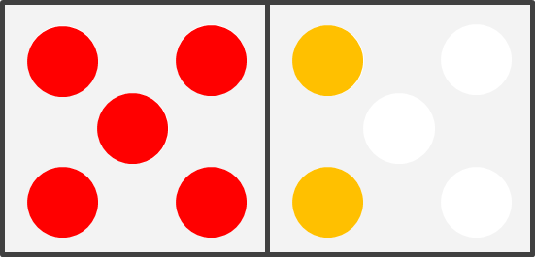
Grown-ups: make this arrangement and briefly show it to your child.
Children: can you copy the arrangement exactly?
Notes:
Grown-ups – Place 5 red counters on one side of the dice frame as shown. Place the two yellow counters on the other side of the frame.
Cover your frame with the paper towel and reveal it briefly. Can you child copy your pattern on their frame?
Try this two or three times. If your child finds it easy when using two colours, try to make patterns using all the same colour.
Starting with 5 red counters (and the other two in yellow) will support the 5 and a bit strategy and simplify identifying the spatial arrangements.
You may wish to start with fewer counters (5) if your child finds this challenging.

Slide 38
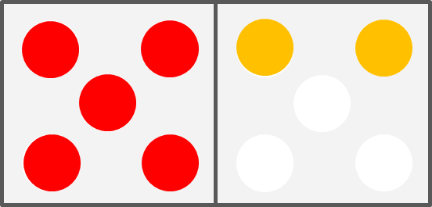
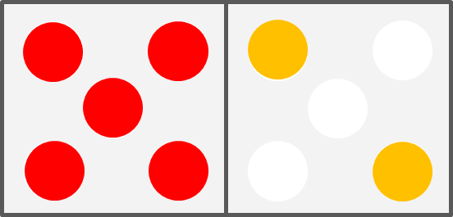
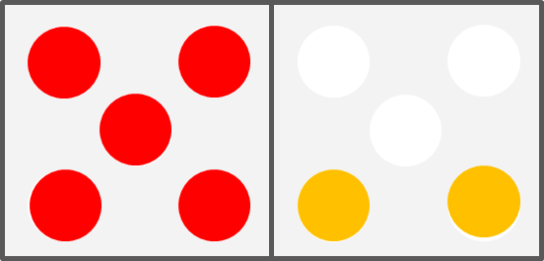
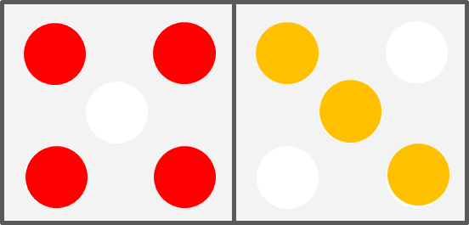
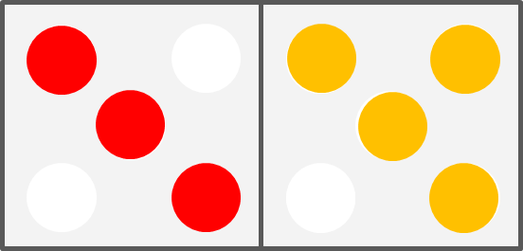
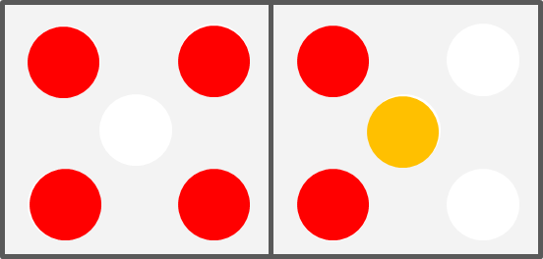
Now try some of these arrangements.
Notes:
Here are some variations to try with 5 red counters and 2 yellow.
Can your child have a ‘quick peep’ at your counters and place their counters in exactly the same place as yours?
Be careful to consider perspectives here – can the child see the counters in the same orientation as the grown-up? They may need to move their seat to do so.
Allow the grown-ups and children time to try out a few of these.
You could also try this using all of one colour.

Slide 39
Play ‘Make it 7’
You will need 10 counters altogether.
Grown-ups – Place some counters (up to 5) on one side of the frame.
Children – place counters on the other side to make 7.
Week 4
Notes:
Allow the children and adults to have a few attempts at this activity. They may choose to show 7 in two colours if they find this easier, or could use all red/yellow counters.

Slide 40
Play ‘Make it 7’
Each player needs to have some double-sided counters (up to 10 each).
One player should put some counters down on the table.
The second player needs to make 7 by adding the correct number of counters. Can you do it without counting?
Use the stem sentence to say how many more makes 7.
Week 4
Notes:
This is the same game that we have just played, but without the support of the dice frame.

Slide 41
Play ‘Make it 7’
Play a game of ‘Make it into 7’ with a partner!
That’s 4! I think 4 needs… 3 to make 7!
_____ needs _____ to make 7.
Mastering Number 2021/22 ncetm.org.uk
Notes:
Now we will practise the same skill, but without the support of the Hungarian Number Frame. This time, the counters will just be placed on the table.
Allow the families to take it in turn to play this game a few times. Encourage them to use the stem sentence to support.

Slide 42
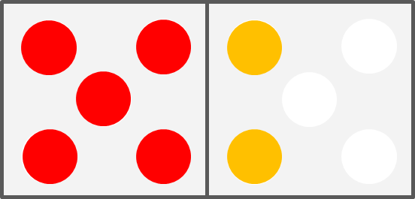
Subitising – 6 or 7
By the end of the five weeks, your children might well be able to subitise patterns with counters and say whether there are 6 or 7.
Week 5

Slide 43
Home Learning
You are going to take all the activities we made today home with you to practise.
The home learning for this week is set out on a sheet with instructions. You will receive a new sheet and some new activities each week.
Notes:
We anticipate each day that you will do ten minutes of practice. Sometimes it may not take 10 minutes which is fine – maybe you could try some of the additional activities on those days.

Slide 44
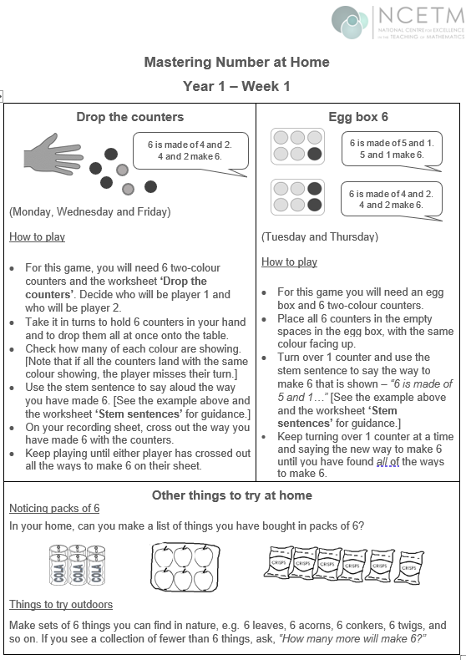
Notes:
Ensure parents have the first home learning sheet in the pack on the day of the workshop so they can see the layout and ask any questions.
1st Click: Shows the ‘drop the counters’ game that we played at the start of today’s session. The home learning sheet and diary asks you to play this on Monday, Wednesday and Friday. Try to keep to this if possible, but if you have to move days around due to other commitments, that is fine.
2nd Click: This shows that you will be finding the ‘parts of 6’ by turning one counter over at a time and using the stem sentence to say the parts you can see. The sheet asks you to play this on Tuesday and Friday.
3rd Click: This section shows some other things that you might like to try at home. It is not essential to do all of these, but they will support your child in their learning if you can fit any of them in.
Where possible, we would like the families to stick to the order of the homework exercises. The additional activities are optional. The might be attempted on the same day, or at the weekend, depending on time.
Some children have clubs during the week and will miss homework. We ask them to try to fit a 10 minute session in at the weekend instead.

Slide 45
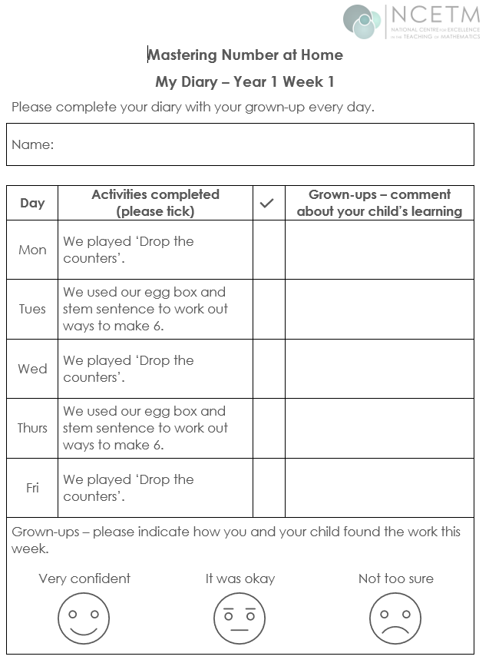
Played with dad. Sam was able to say see all the parts of 7.
Notes:
Class teachers - Please ensure the parents have the homework diary in the pack at the workshop so they can easily follow the instructions and can ask any questions.
If your homework is not sent out on a Friday, that is fine – the families should start the diary on the day when they receive the homework and should return it on the same day the following week.
We are asking the grown-ups to play the games on the days indicated on the sheet, although there is flexibility on this and some could be done at the weekend. Emphasise that we do not want them to spend more than 10 minutes each day on this. It can also be shared by family members and doesn’t have to be done with the person who attends the workshop.
It would be helpful if the grown-ups made a comment each day to show how well their child attempted the work, any success stories and what the parent is ‘noticing’ about the child’s learning. Ask the grown-up to circle the most appropriate face at the bottom to show how confident they and their child felt about this week’s work.
The home learning should be sent out in the usual way for your class. The diary should be completed from whatever day the diary is sent out (i.e. if home learning is sent out on Wednesdays, the children should complete the Wednesday task that night on their diary and the parent should work in order from there). Please request parents to ensure the diary is returned the following week so that a new one and new activities can be issued.
There is no need to ‘mark’ the diary and return it with comments (unless you really want to!). It would be good to note where children are not completing the tasks, not returning the diary, or indicating that they are not confident so that you might make some suggestions for adaptations, where necessary.

Slide 46
References:
Department for Education: Development Matters (2023) Available at: Development Matters - GOV.UK (www.gov.uk) (Accessed 27-09-23)

Slide 47
Thank you!

Slide 48
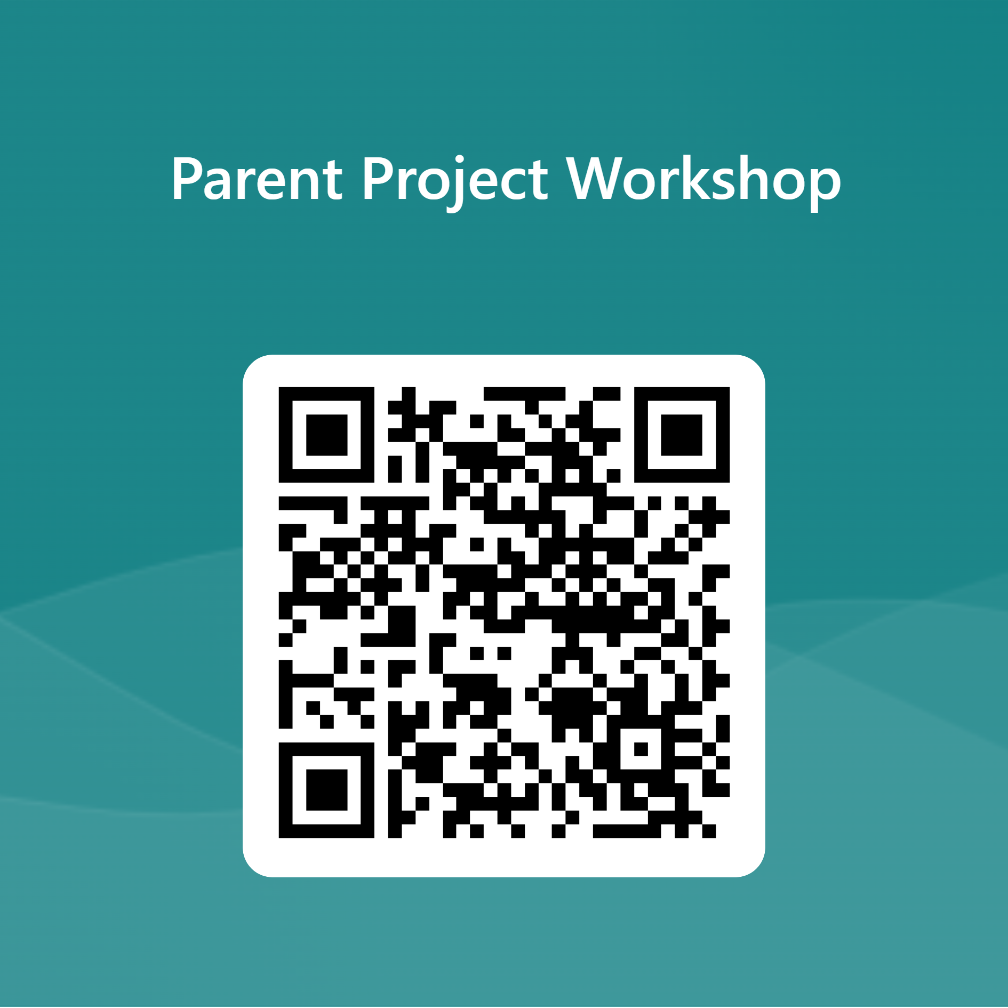
Survey for schools – after each parental workshop
https://forms.microsoft.com/e/vQmZZ1HW4Y
Use this form to tell the national Parent Project team about who you've worked with. Complete the form for each individual workshop.
If you have any questions about this survey, please contact your local Maths Hub or email mathshubs@ncetm.org.uk

Slide 49

Survey for parents and carers – post-project impact
https://forms.microsoft.com/e/3PfpjanJe9
We ask that this link should be distributed by schools to the parents involved in the project.

